Slide 1
Singapore Management University
QF 635 Market Microstructure and Algorithmic Trading
Pairs Trading Strategy
Group members：
Xia Qinru,
Song Yang,
Gou Xinwen,
Liu Yue,
Xia Tian,
Hao Xuanheng.
SMU QF635 Project

Slide 2
1
Strategy Introduction
2
Cointegration Test
CONTENTS
3
Build strategy and backtest
4
Add Stop-Loss Strategy
5
Other Risk Management

Slide 3
1
PART
Strategy Introduction

Slide 4
01 Strategy Introduction
02 Cointegration Test
03 Strategy Backtesting
04 Stop-Loss
05 Other Risk Management
What is pairs trading?
Pairs Trading:
in its original form involves identifying two companies which should fundamentally have the very similar businesses.
Assumption:
temporary “spread” between two different instruments should eventually converge, and we should realize a profit as the spread converges back to 0.
Strategy:
we need to go long the financial instrument which is temporarily undervalued, and short the instrument which is temporarily overvalued.

Slide 5
01 Strategy Introduction
02 Cointegration Test
03 Strategy Backtesting
04 Stop-Loss
05 Other Risk Management
How to indentify pairs?
01
Correlation
02
Cointegration
03
Distance
compute the correlation between the price series of both legs then shortlist pairs where two legs has a correlation above a cutoff
cointegration means the linear combination of the variables is stationary; any deviation is temporary and transient
their distances below a threshold are grouped into pairs; trade the pair when distance increase and close when position falls
In our trading strategy, we choose to use cointegration method to build pairs

Slide 6
01 Strategy Introduction
02 Cointegration Test
03 Strategy Backtesting
04 Stop-Loss
05 Other Risk Management
Strategy Workflow
Identify industry -- Select target instruments -- Market data Gateway
Test for cointegration
Identify trading pairs
Use the past two years of data to test for cointegration (Swap the positions of X and Y)
Select the trading pairs with the strongest cointegration relationship
Calculate beta and alpha (through OLS)
Calculate spread
(spread = Y-a-bX)
Calculate z-scores
(normalize spread)
Identify trading signals and positions
Add stop-loss -- Order gateway -- Calculate performences

Slide 7
2
PART
Cointegration Test

Slide 8
01 Strategy Introduction
02 Cointegration Test
03 Strategy Backtesting
04 Stop-Loss
05 Other Risk Management
Step1: Get trading data
Our pairs trading strategy focuses on the cryptocurrency industry because the high volatility and extended trading hours
Remove columns with a high number of null values.
Remove:’NOTUSDT’,’SOLUSDT’,’YGGUSDT’
Select industry
Get trading data
Clean data
Plot close price
1
2
3
4
Get hourly data (2020-01-01 to 2024-05-31):
'BTCUSDT', 'ETHUSDT',
'SOLUSDT','ADAUSDT','BNBUSDT', 'LTCUSDT','NOTUSDT','XLMUSDT',
'BCHUSDT','LINKUSDT','XRPUSDT',
'YGGUSDT','EOSUSDT'
Plot the price fluctuations of the various cryptocurrencies over time, standardizing the prices with the latest data as the baseline.

Slide 9
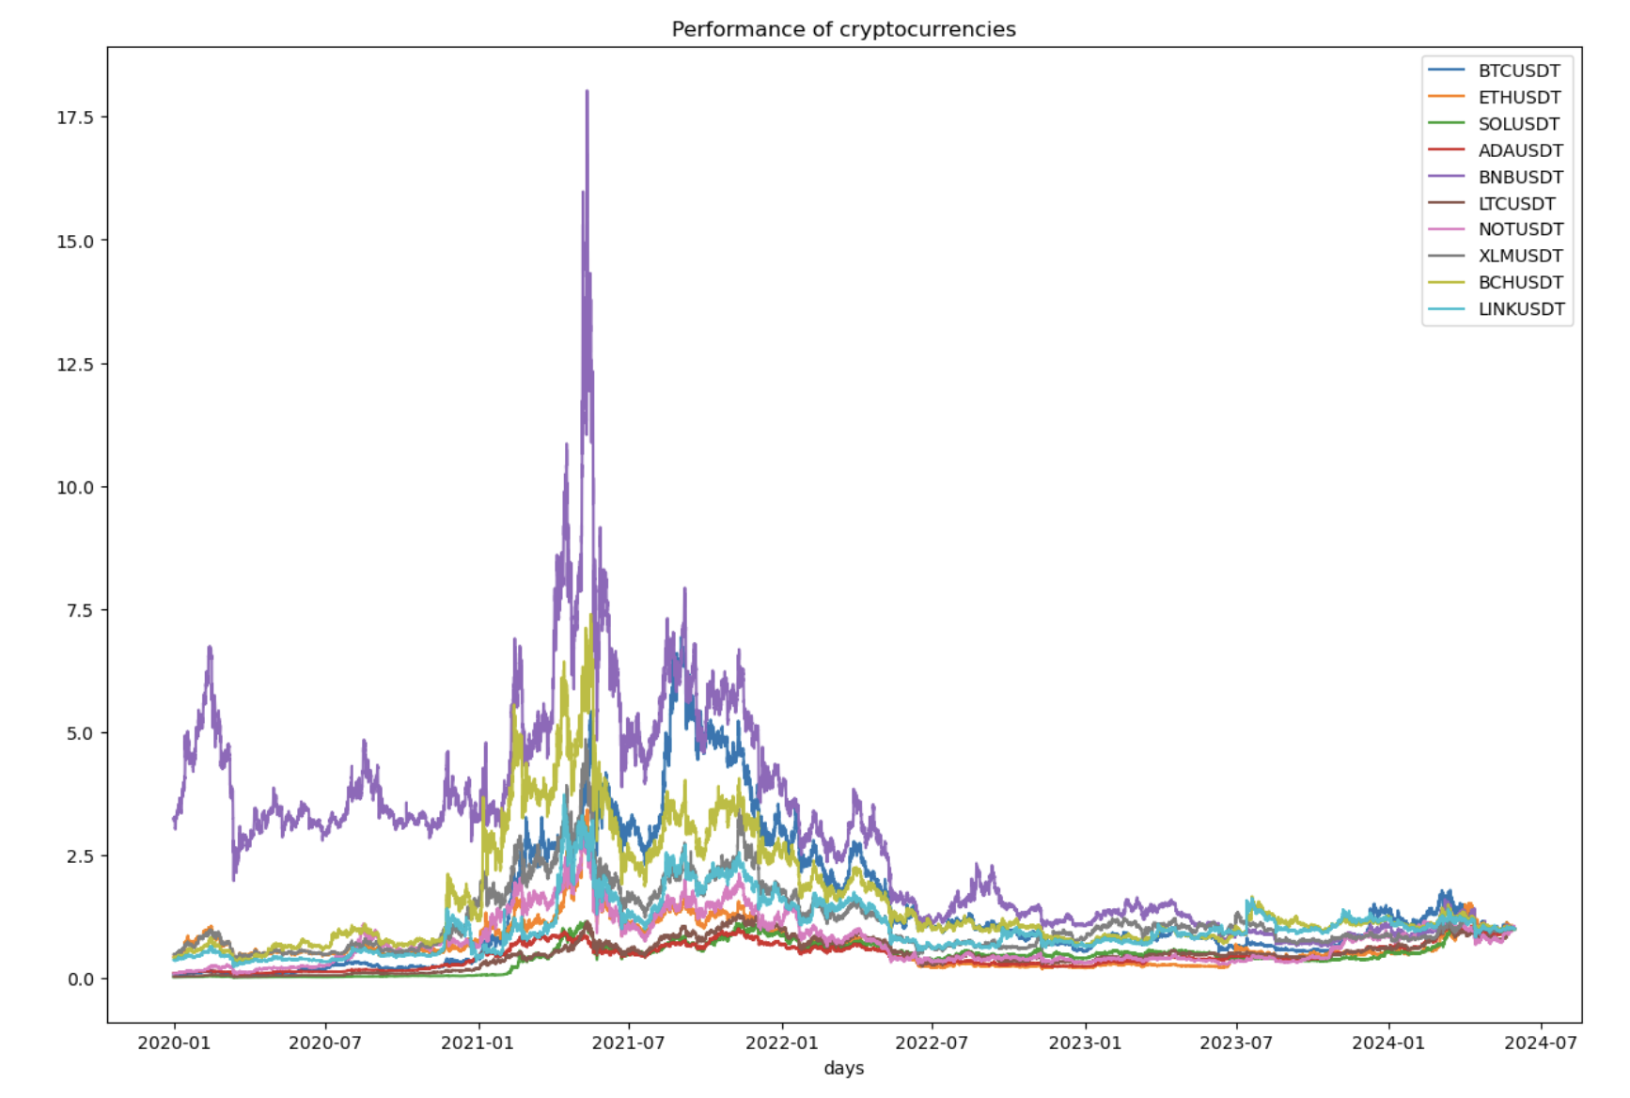

Slide 10
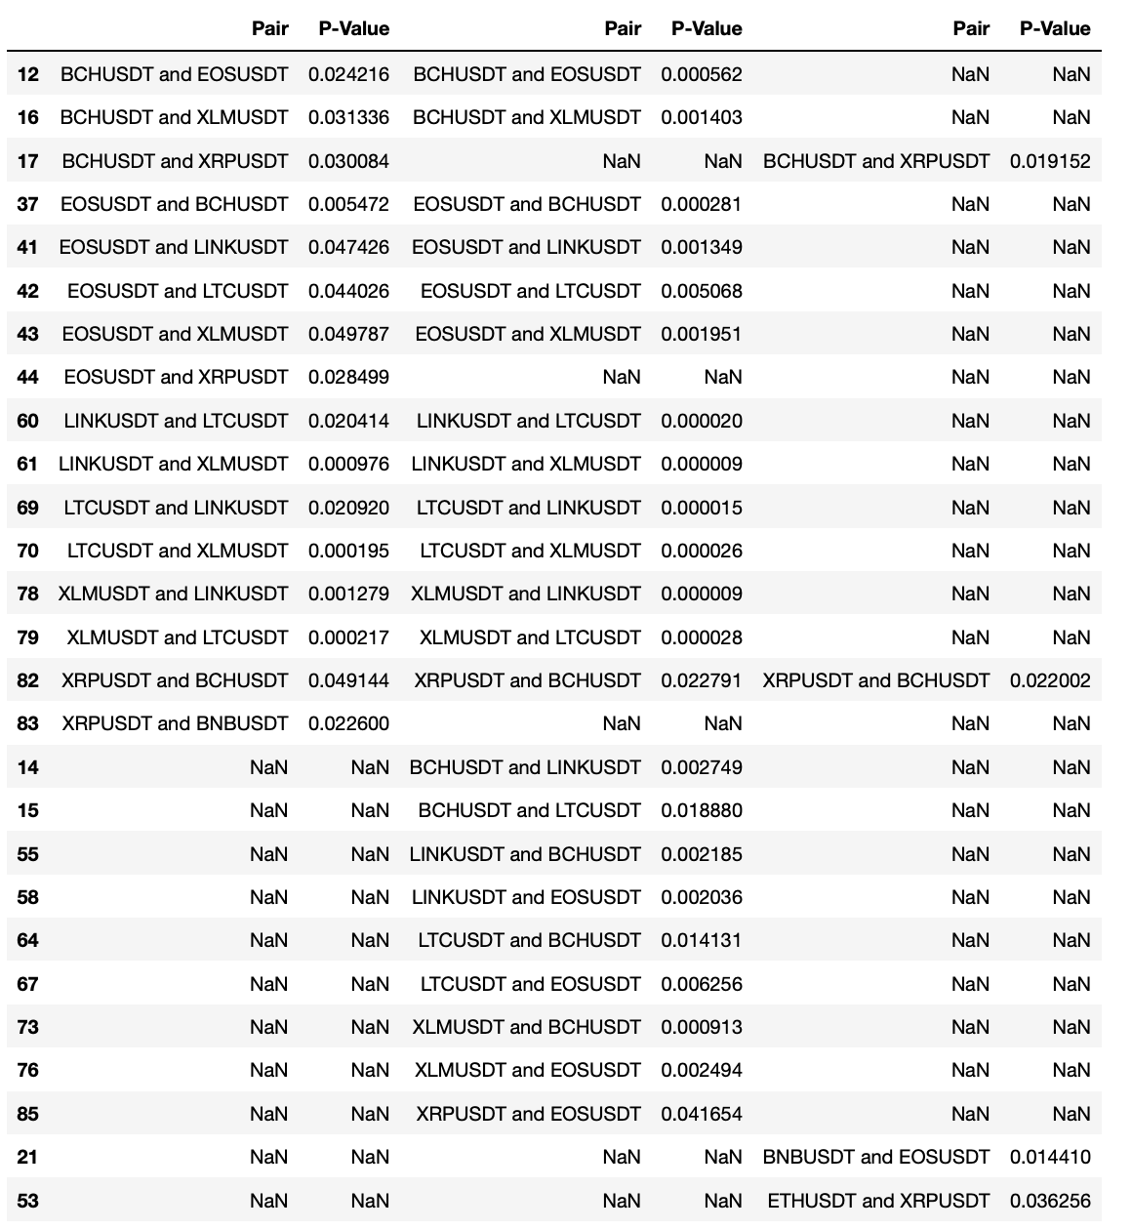
Step2: Cointegration test
Cointegration
Test for cointegration using two years of price information, with updates for each end year，i.e. January 2020 to December 2021.
1
2
The more times the cointegration relationship is satisfied, the more stable the cointegration relationship.
3
Best pair：
‘XRPUSDT’VS‘BCHUSDT’

Slide 11
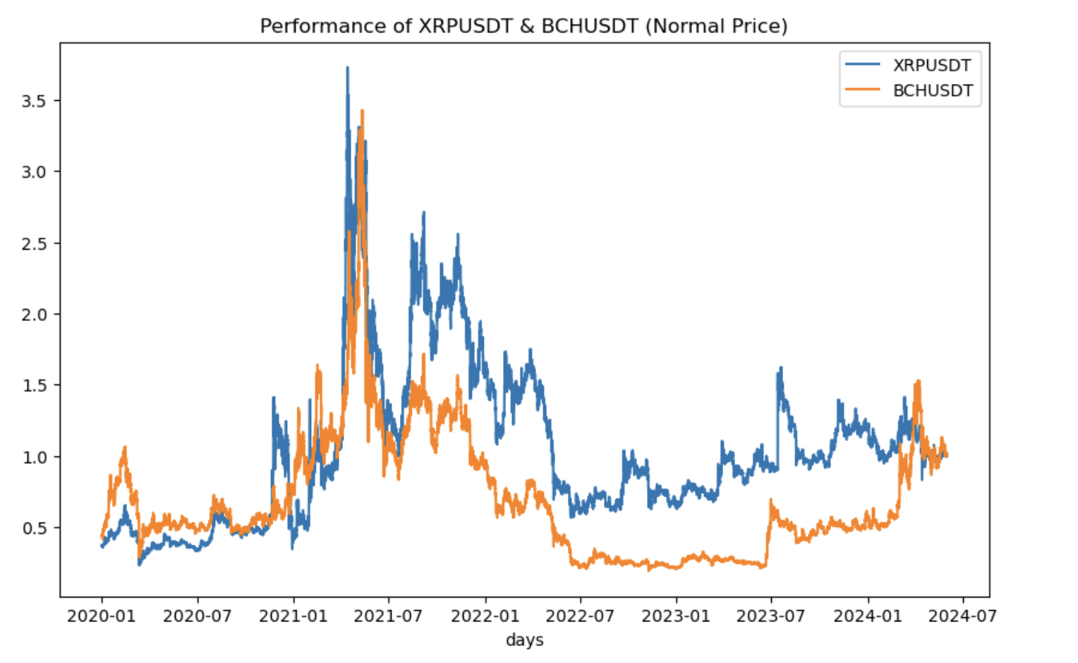

Slide 12
3
PART
Build strategy and backtest

Slide 13
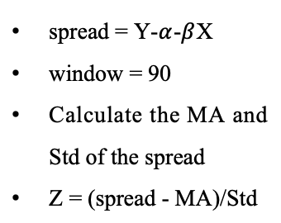
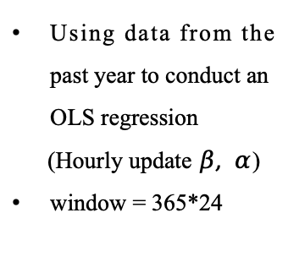
01 Strategy Introduction
02 Cointegration Test
03 Building strategy
04 Stop-Loss
05 Other Risk Management
Building strategy
Pairs trading
Divide data
Rolling OLS
Calculate Z-scores
Find Signals
Training Data:
2020-01 to 2023-12
Test Data：
2024-01 to 2024-05
Using data from the past year to conduct an OLS regression
(Hourly update $β, α$)
window = 365*24
spread = Y-$α$-$β$X
window = 90
Calculate the MA and Std of the spread
Z = (spread - MA)/Std
If Z > 1.96 and |spread| > 0.005, short spread
If Z < 1.96 and |spread| > 0.005, long spread
If Z < 0.25, close out
Calculate performance: Sharp ratio, Average annual return, Total return, Max drawdown, Max drawdown period
Backtest in training data and test data and check the profit and loss situation of the strategy

Slide 14
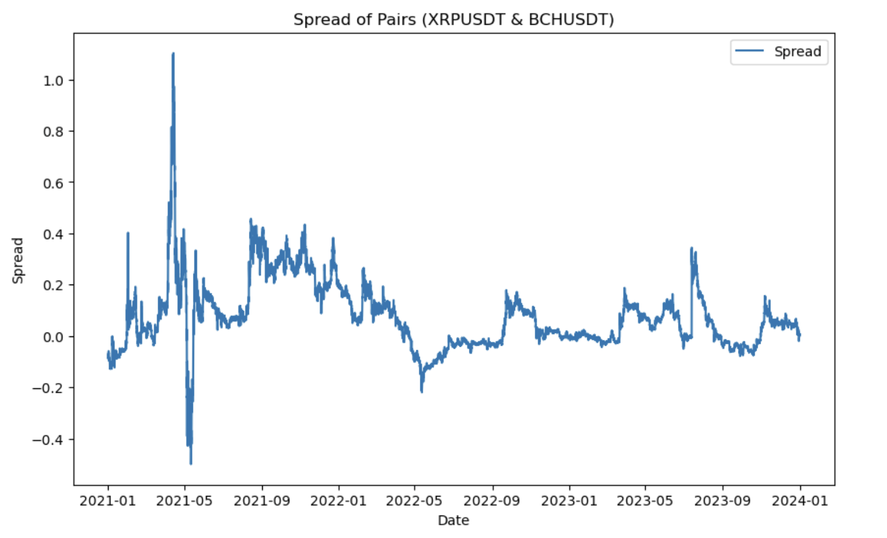
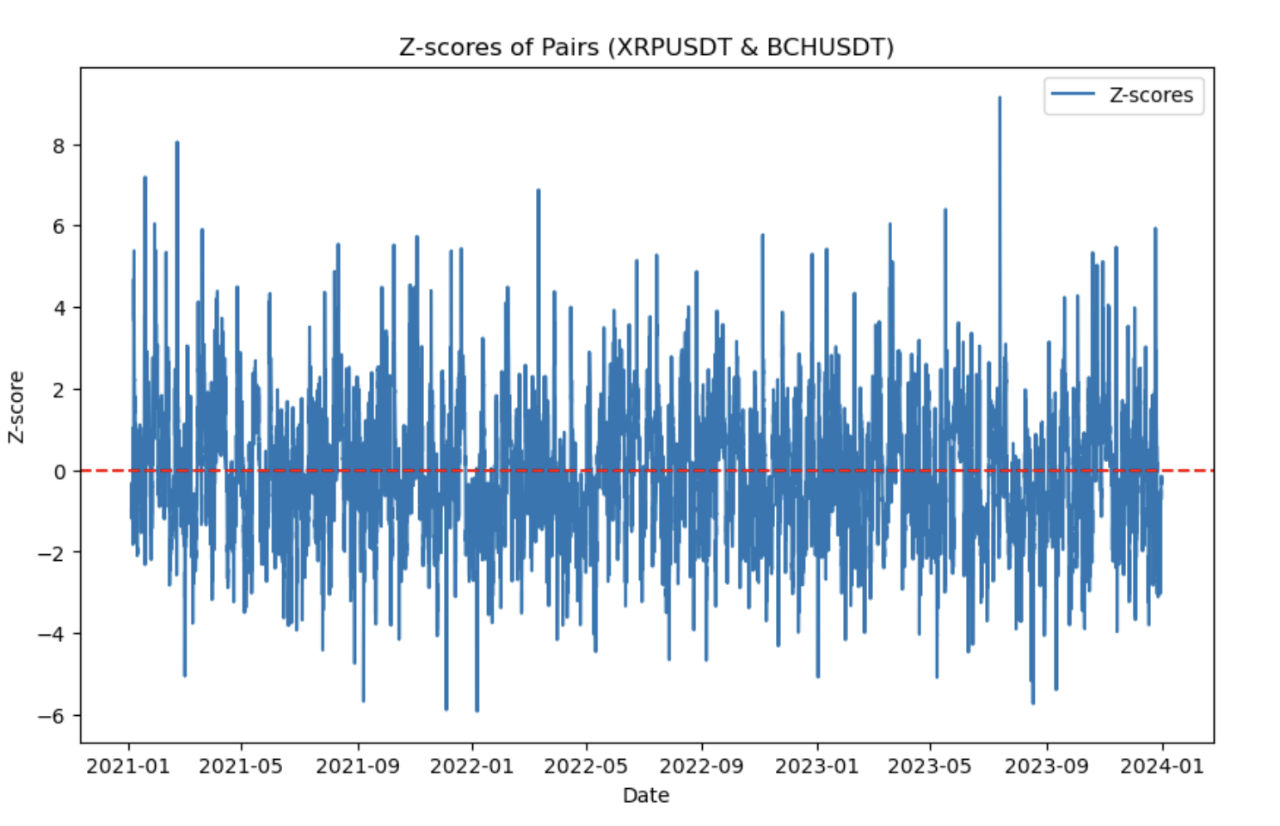
01 Strategy Introduction
02 Cointegration Test
03 Building strategy
04 Stop-Loss
05 Other Risk Management
1. Backtest in training data (2021-2023)
Spread from 2021 to 2023
Z-scores from 2021 to 2023
Explanation
The spread fluctuated around zero from January 2021 to December 2023, indicating that the pairs trading strategy maybe feasible.At the same time, it can be seen that extreme market conditions occurred in 2021.

Slide 15
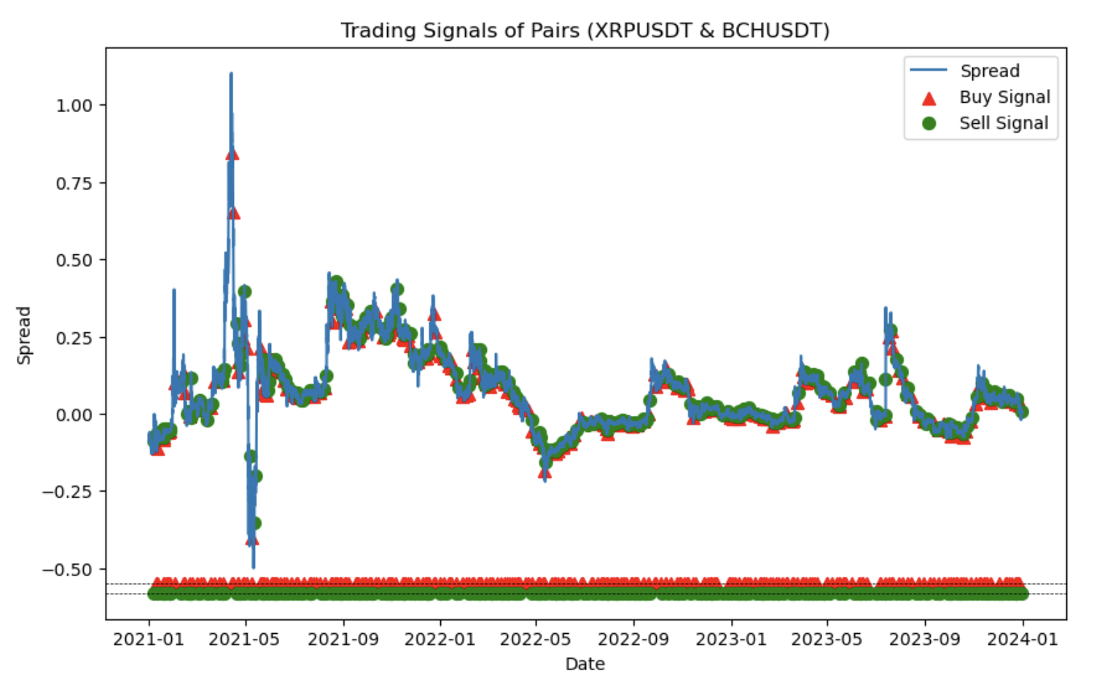
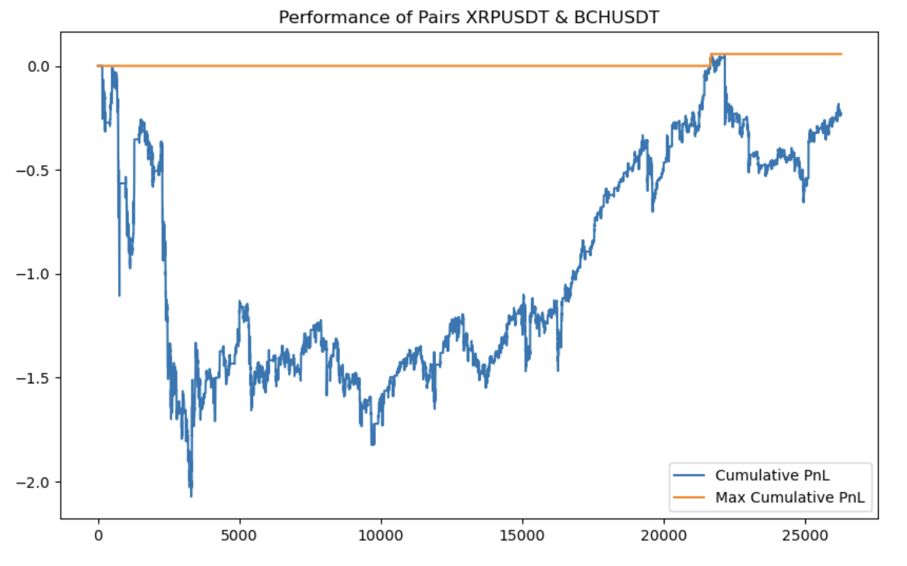
01 Strategy Introduction
02 Cointegration Test
03 Building strategy
04 Stop-Loss
05 Other Risk Management
1. Backtest in training data (2021-2023)
Trading signals
Strategy performance
Explanation
The strategy performed poorly overall from 2021 to 2023, likely due to the extreme market conditions in 2021. Next, we will exclude abnormal market conditions and backtest the strategy's combined performance from 2022 to 2023.

Slide 16
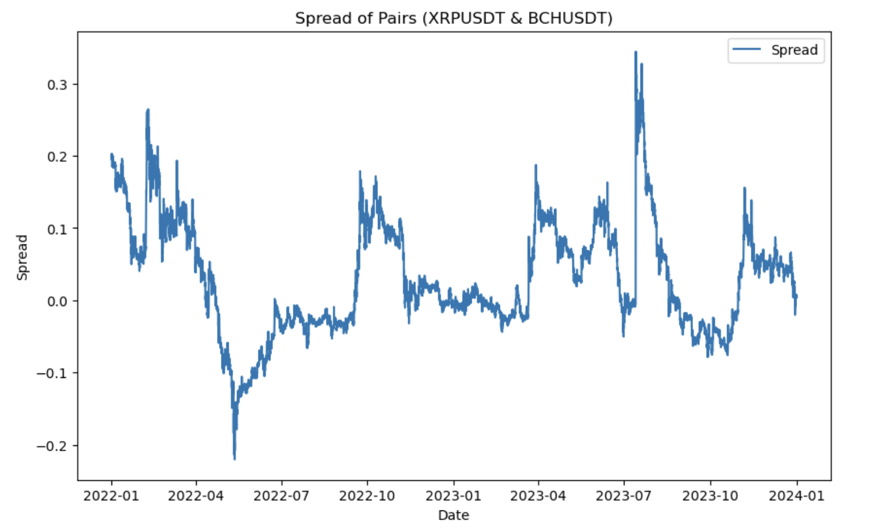
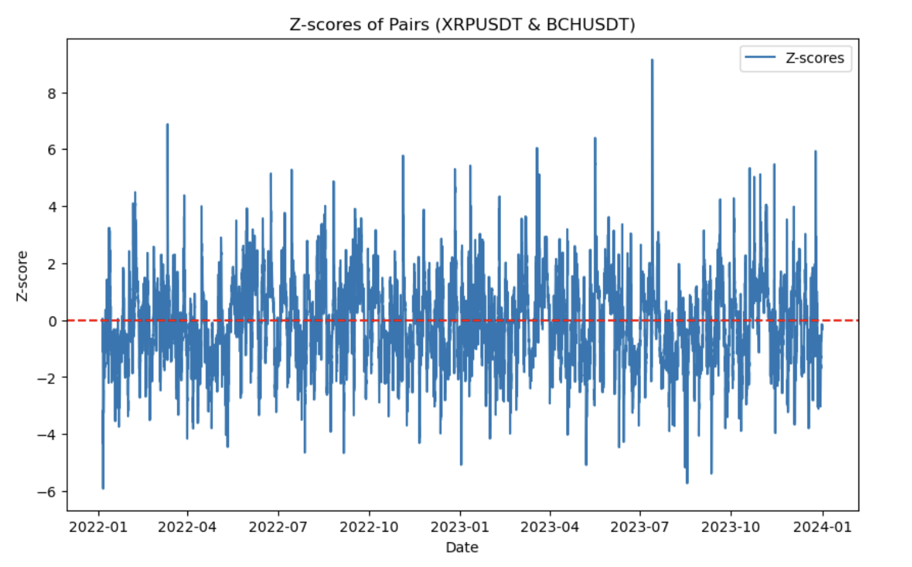
01 Strategy Introduction
02 Cointegration Test
03 Building strategy
04 Stop-Loss
05 Other Risk Management
2. Backtest in training data (2022-2023)
Spread from 2022 to 2023
Z-scores from 2022 to 2023
Explanation
Compared to the period from 2021 to 2023, the spread has shown significantly reduced variance, with no drastic fluctuations, maintaining stable movement around zero.Thus, the strategy's performance may improve.

Slide 17
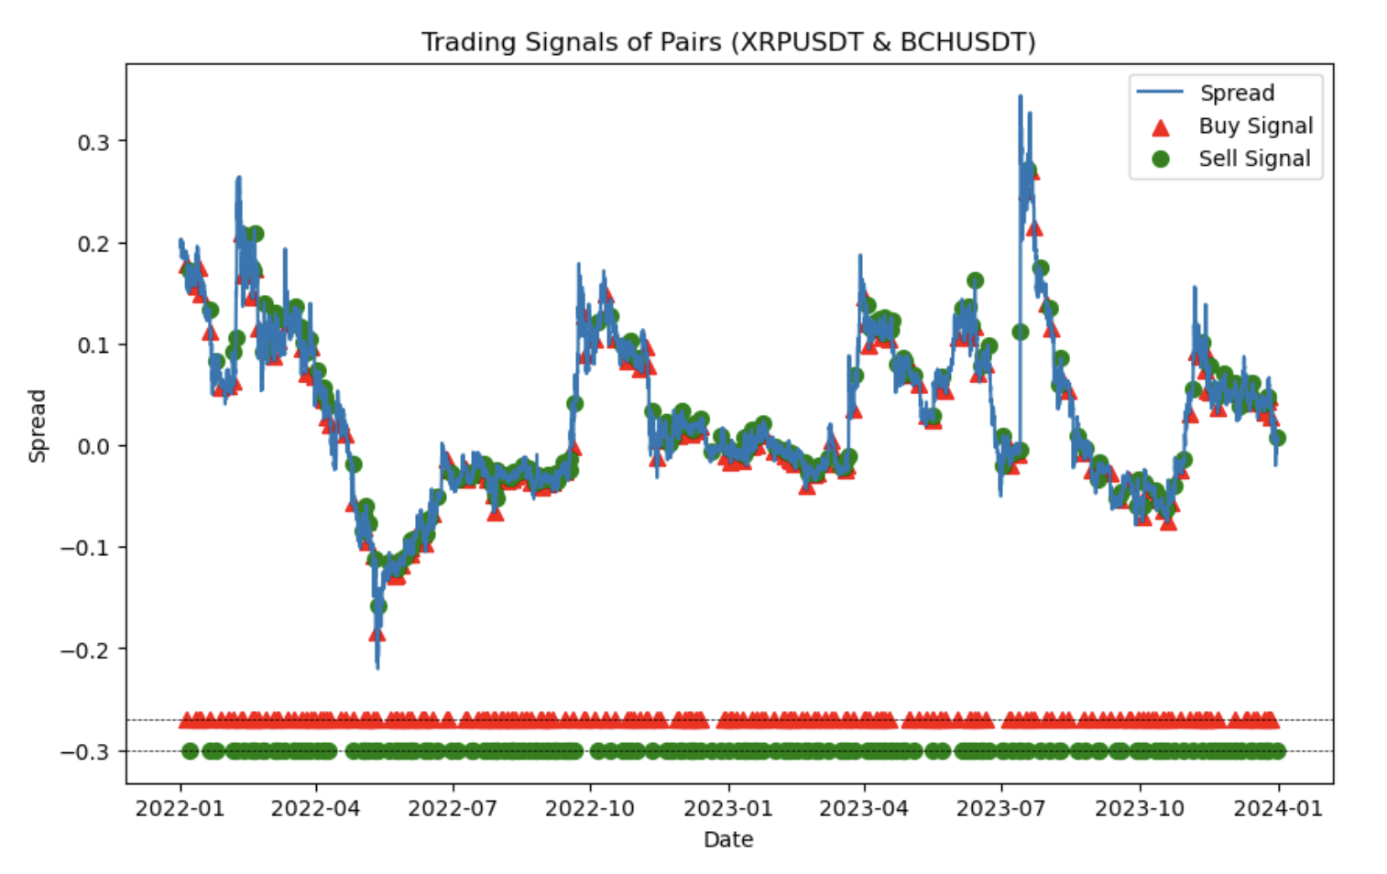
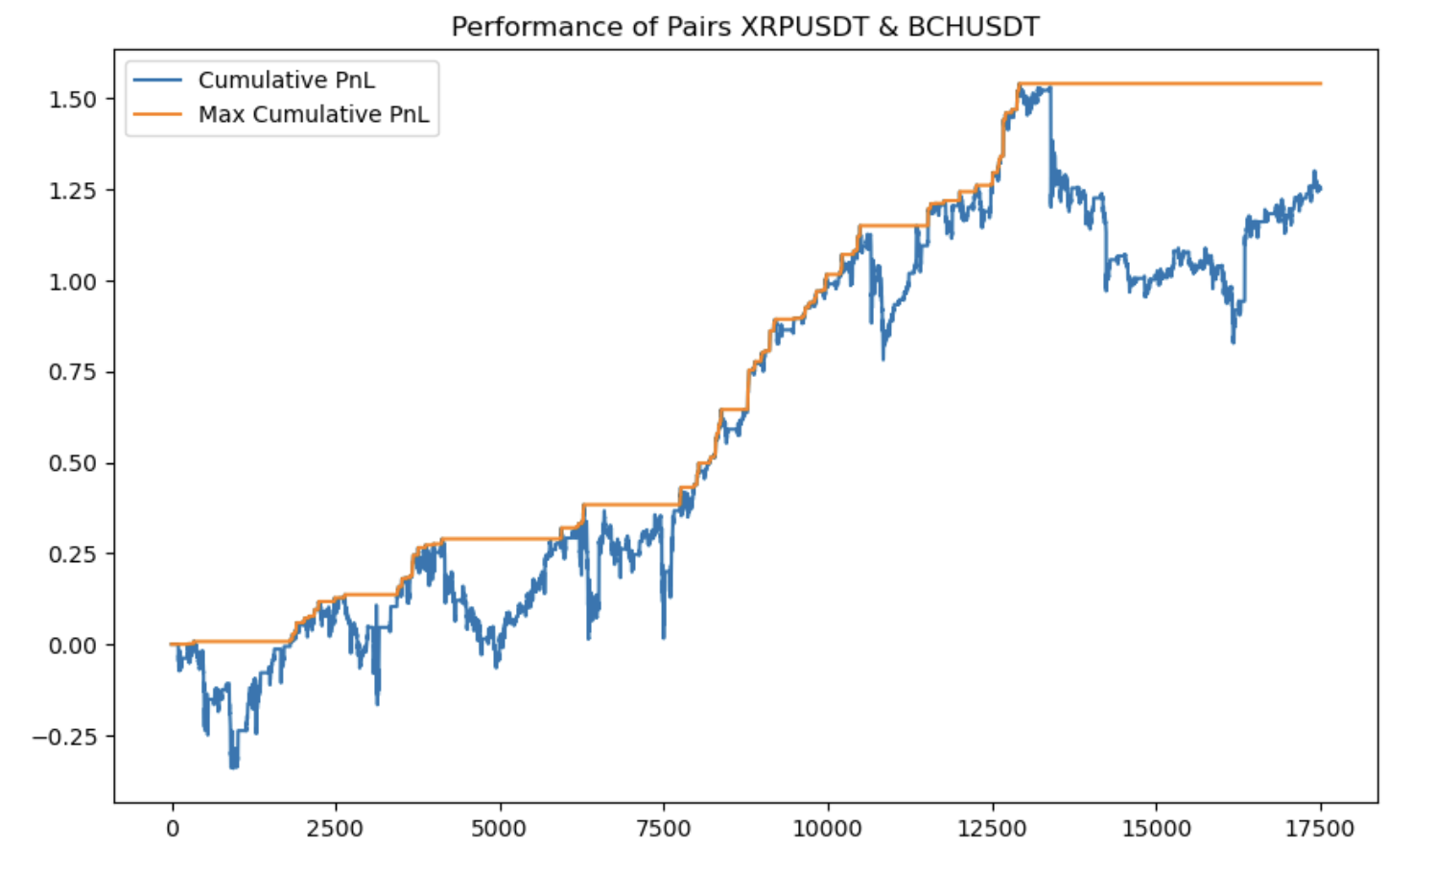
01 Strategy Introduction
02 Cointegration Test
03 Building strategy
04 Stop-Loss
05 Other Risk Management
2. Backtest in training data (2022-2023)
Trading signals
Strategy performance
Explanation
After excluding extreme market conditions, the strategy performed well overall from 2022 to 2023. Next, we will separately backtest the strategy's performance in each individual year: 2021, 2022, and 2023.

Slide 18
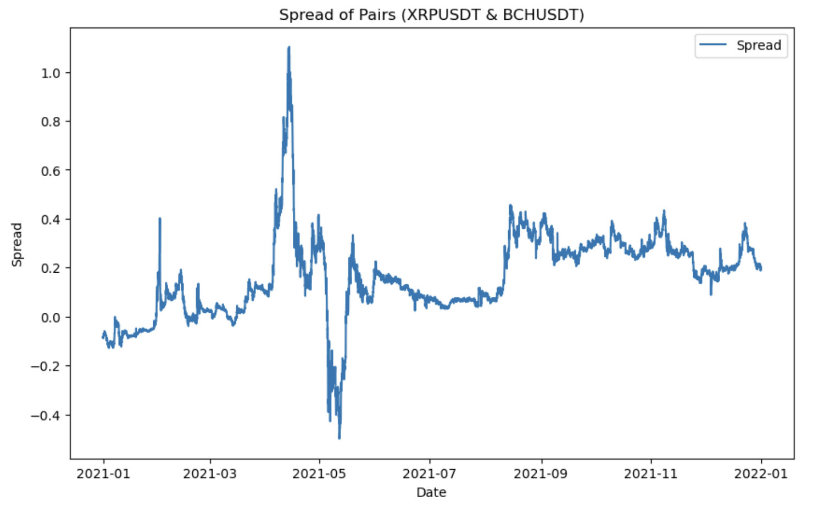
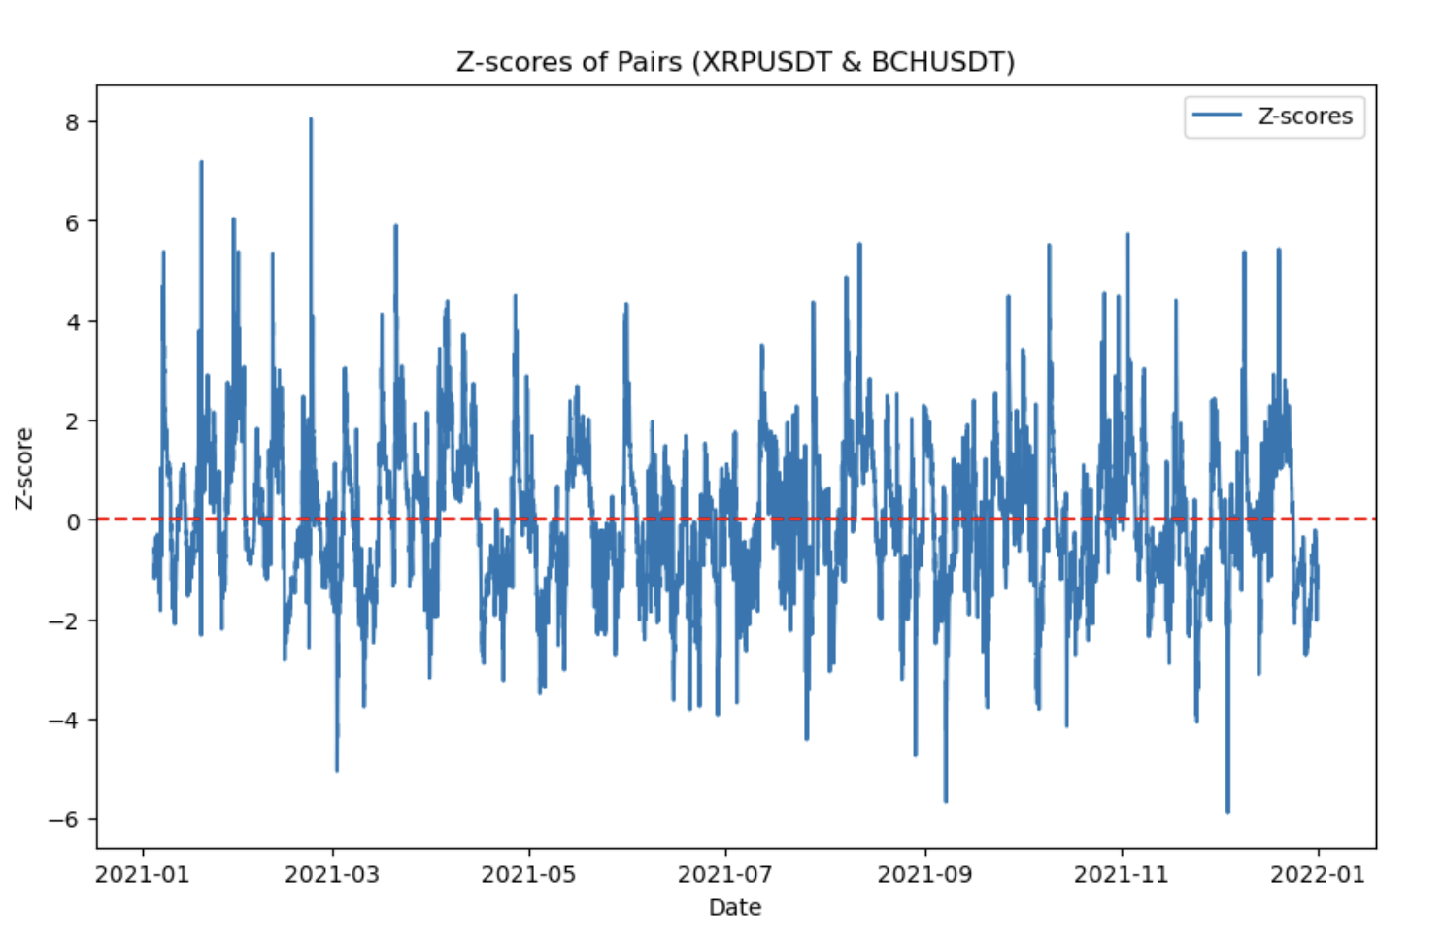
01 Strategy Introduction
02 Cointegration Test
03 Building strategy
04 Stop-Loss
05 Other Risk Management
3. Backtest in training data (Single year-2021)
Spread in Year 2021
Z-scores in Year 2021
Explanation
In May 2021, the spread experienced significant fluctuations. Our pairs trading strategy anticipated that the spread would revert to zero soon. This market condition posed a substantial risk of losses.

Slide 19
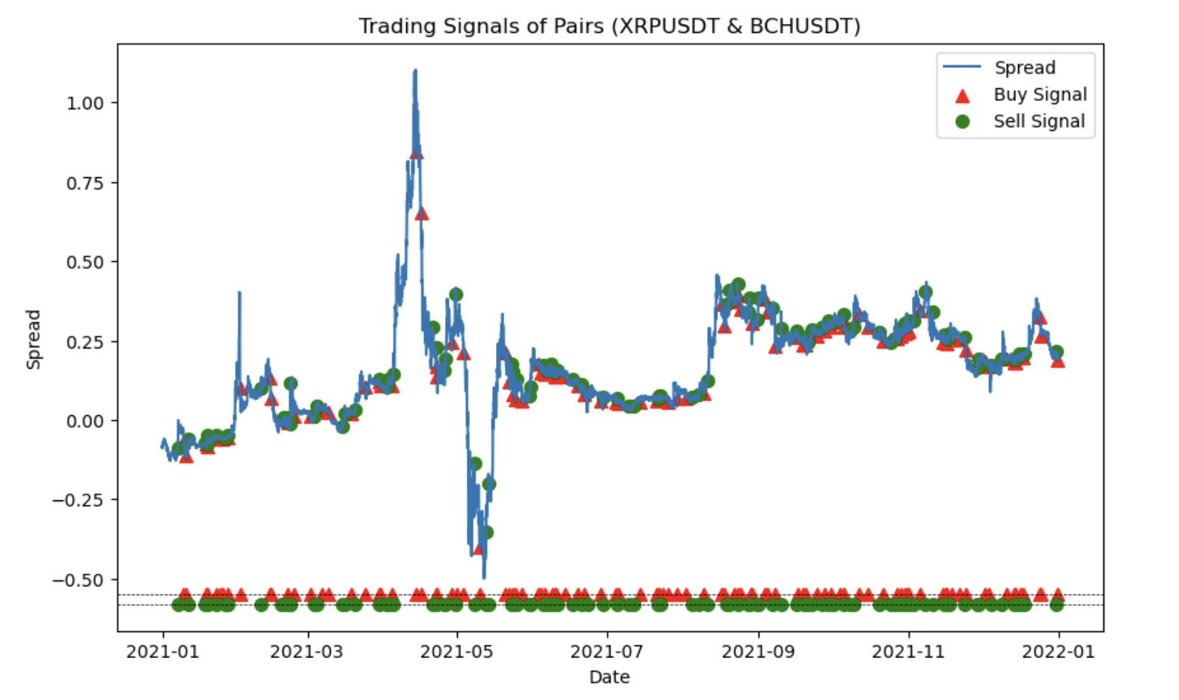
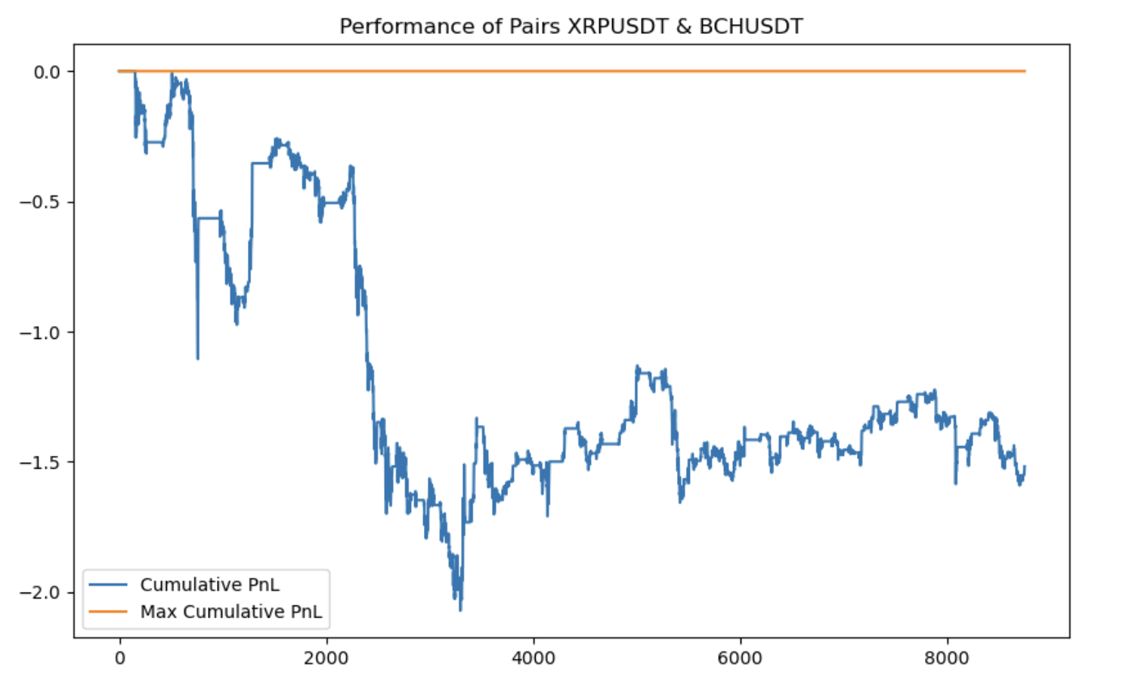
01 Strategy Introduction
02 Cointegration Test
03 Building strategy
04 Stop-Loss
05 Other Risk Management
3. Backtest in training data (Single year-2021)
Trading signals
Strategy performance
Explanation
It can be seen that the strategy sustained negative returns throughout 2021, indicating very poor performance during extreme market conditions. We need to consider implementing a stop-loss strategy. We will discuss this later.

Slide 20
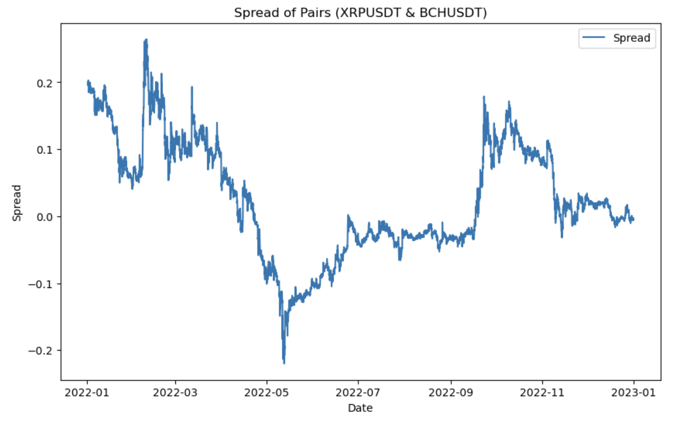
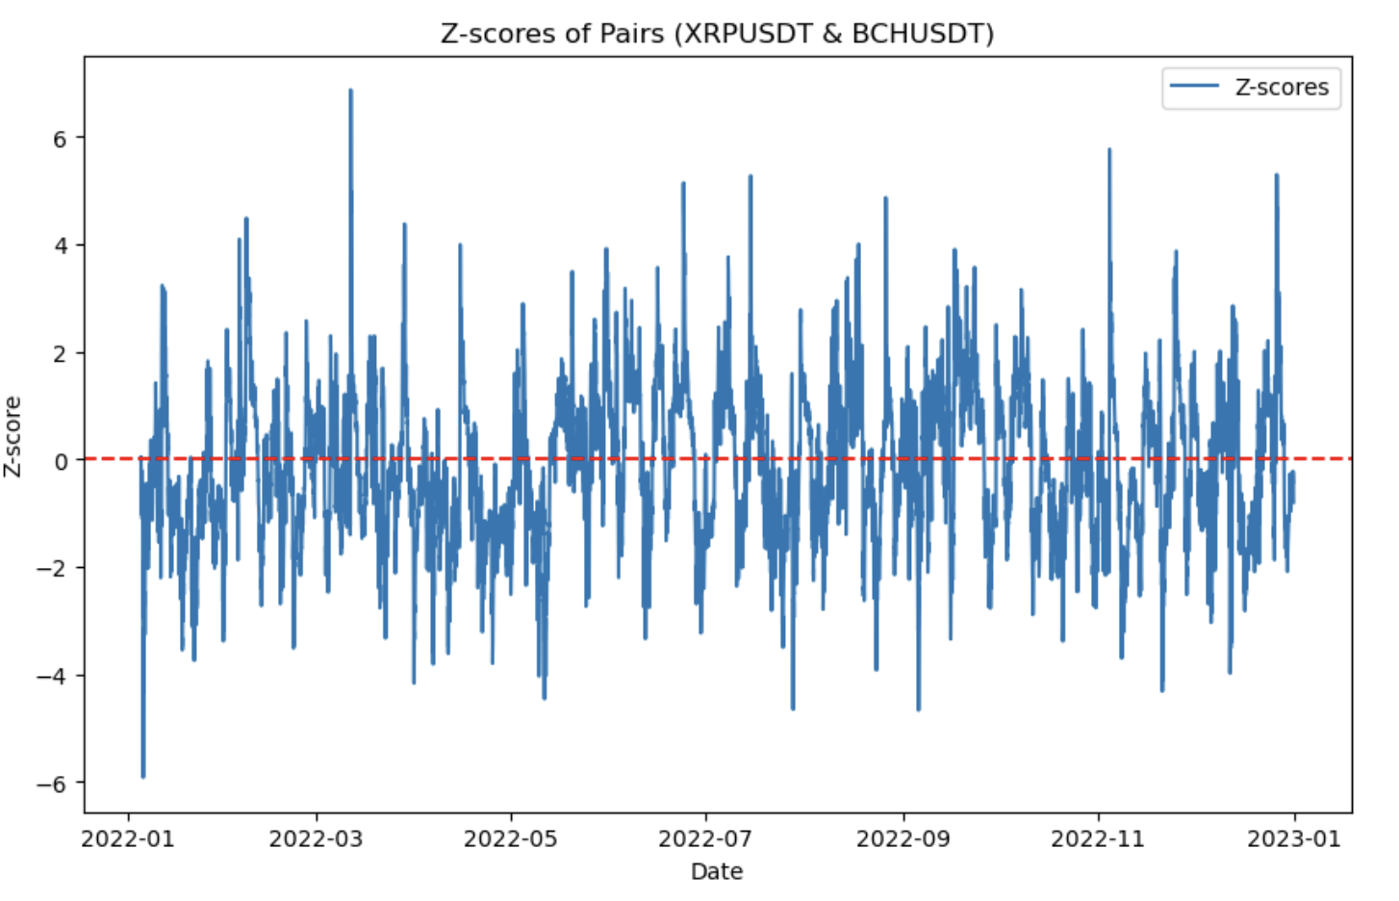
01 Strategy Introduction
02 Cointegration Test
03 Building strategy
04 Stop-Loss
05 Other Risk Management
4. Backtest in training data (Single year-2022)
Spread in Year 2022
Z-scores in Year 2022
Explanation
In 2022, the range of spread fluctuations was between -0.2 and 0.2, significantly smaller compared to 2021, indicating a greatly reduced variance.

Slide 21
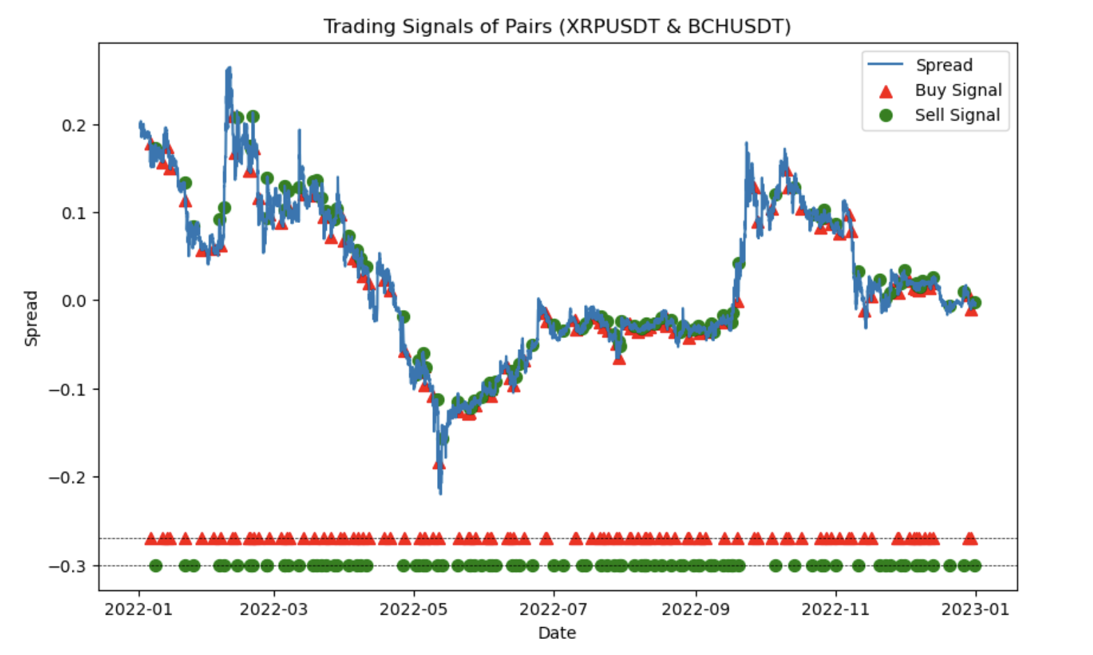
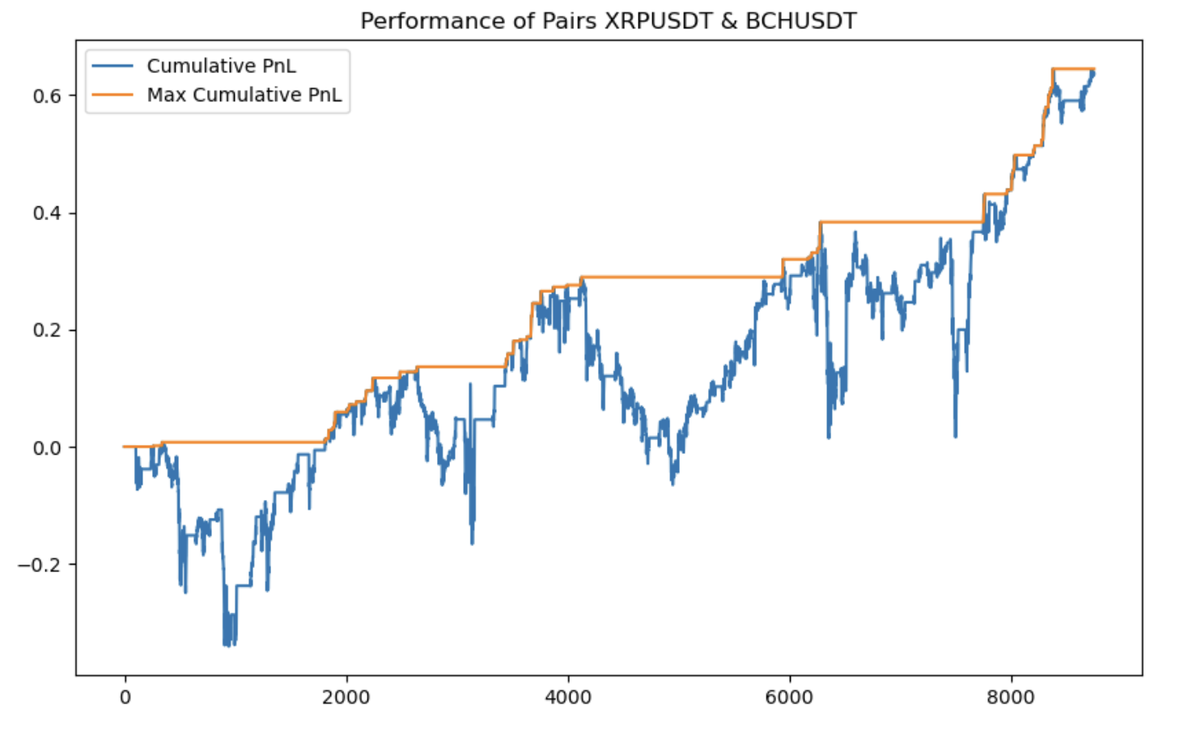
01 Strategy Introduction
02 Cointegration Test
03 Building strategy
04 Stop-Loss
05 Other Risk Management
4. Backtest in training data (Single year-2022)
Trading signals
Strategy performance
Explanation
In 2022, the returns showed a gradual upward trend, with cumulative P&L exceeding 0.6. However, there was a significant drawdown over the long term, which occurred due to the absence of implementing a stop-loss strategy.

Slide 22
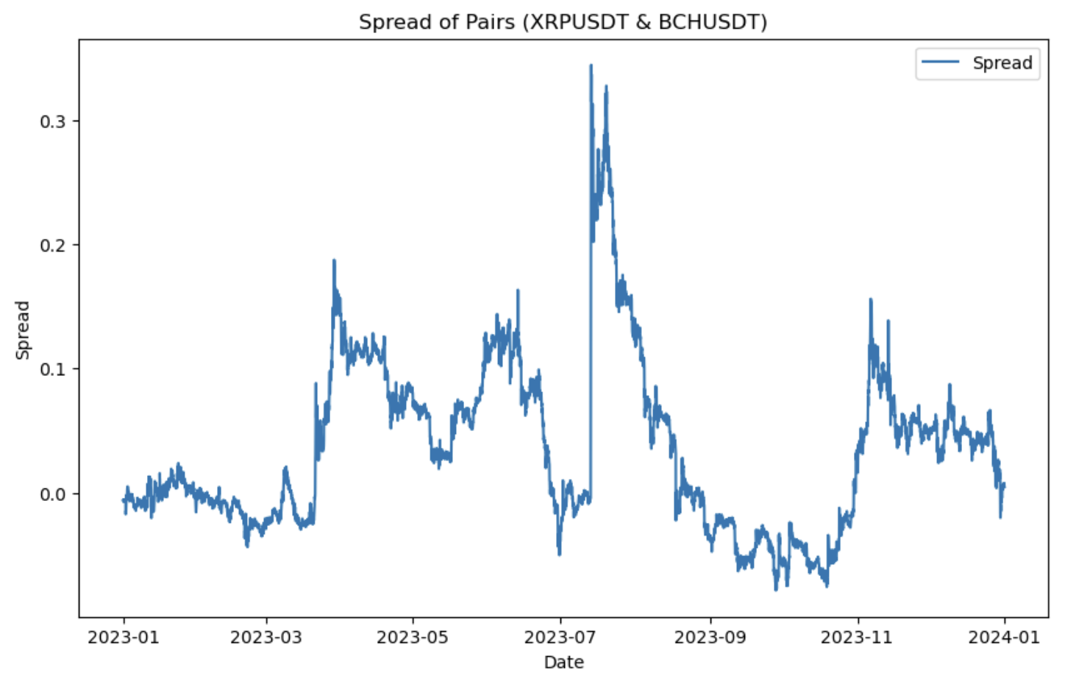
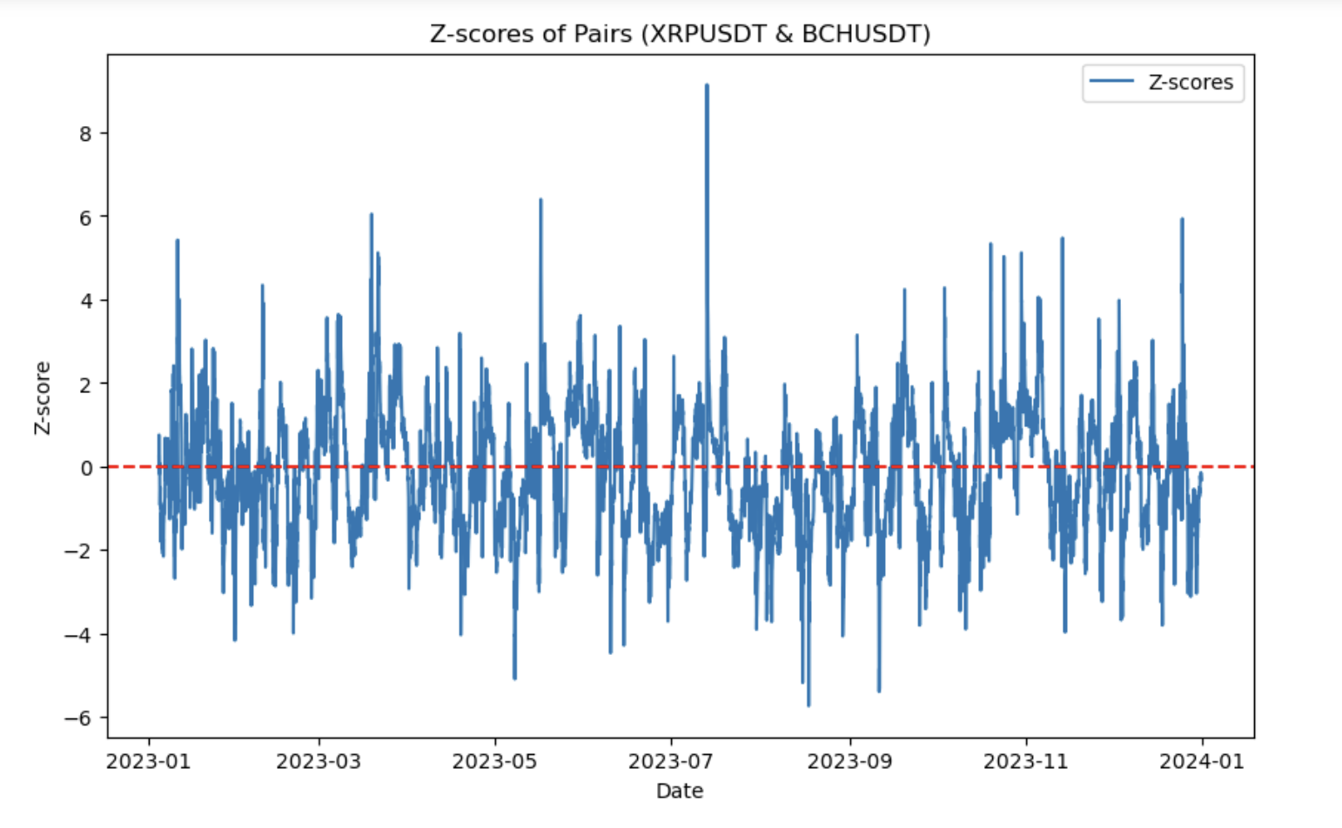
01 Strategy Introduction
02 Cointegration Test
03 Building strategy
04 Stop-Loss
05 Other Risk Management
5. Backtest in training data (Single year-2023)
Spread in Year 2023
Z-scores in Year 2023
Explanation
In 2023, the range of spread fluctuations expanded compared to 2022, yet it still fluctuated around zero. This indicates that the strategy can be effective but may face significant drawdowns.

Slide 23
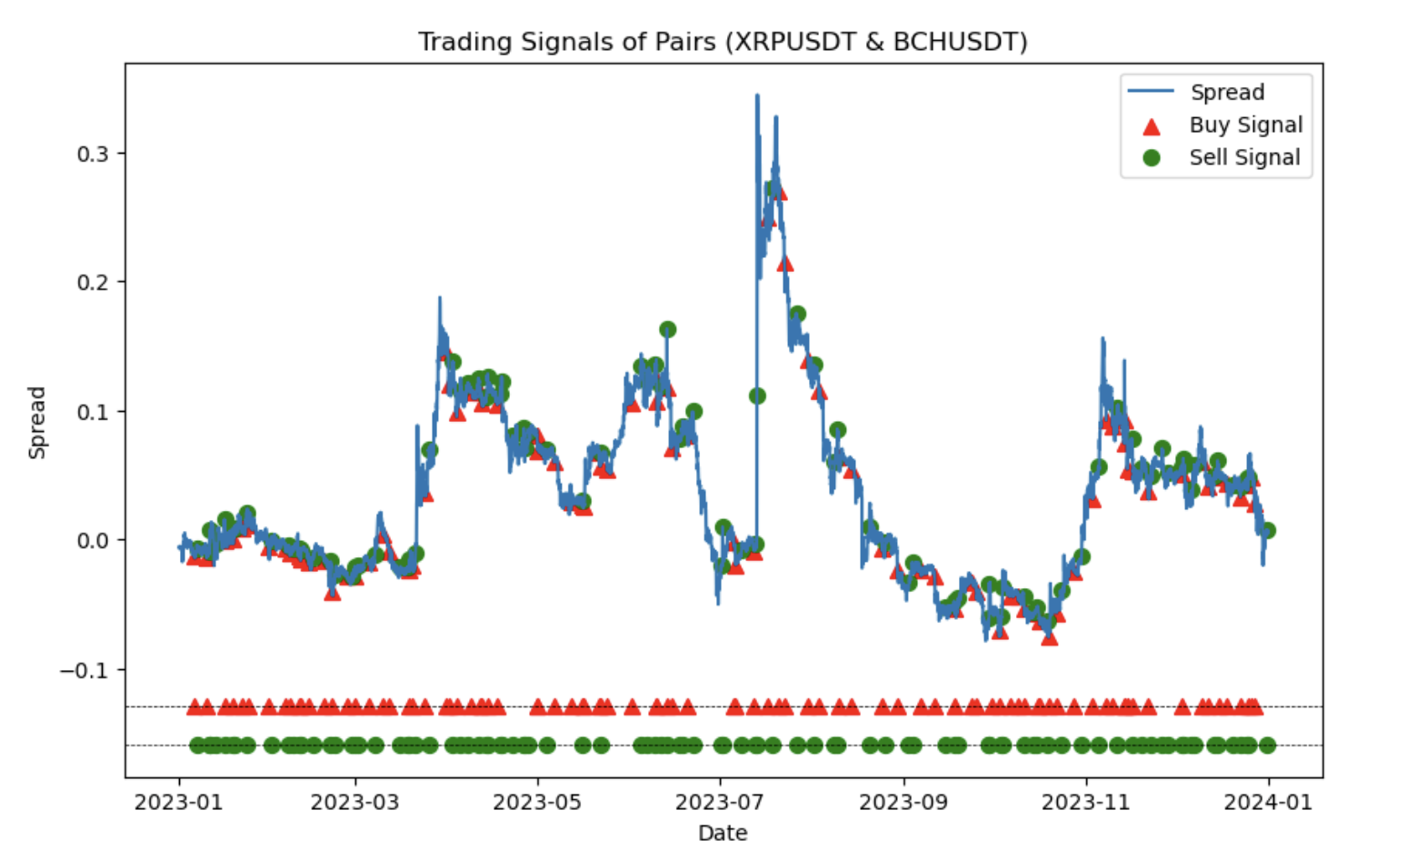
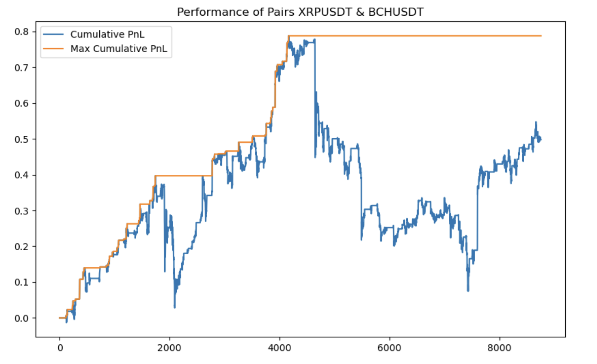
01 Strategy Introduction
02 Cointegration Test
03 Building strategy
04 Stop-Loss
05 Other Risk Management
5. Backtest in training data (Single year-2023)
Trading signals
Strategy performance
Explanation
By 2023, cumulative returns had reached as high as 0.8, but subsequently, there was a significant long-term drawdown. This occurred because of signal reversals in trading direction due to intense spread fluctuations. Once again, this underscores the necessity of implementing a stop-loss strategy.

Slide 24
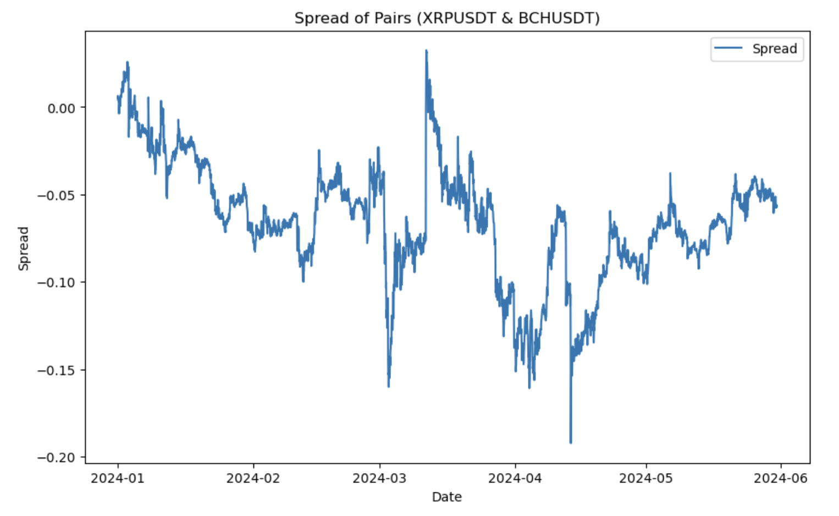
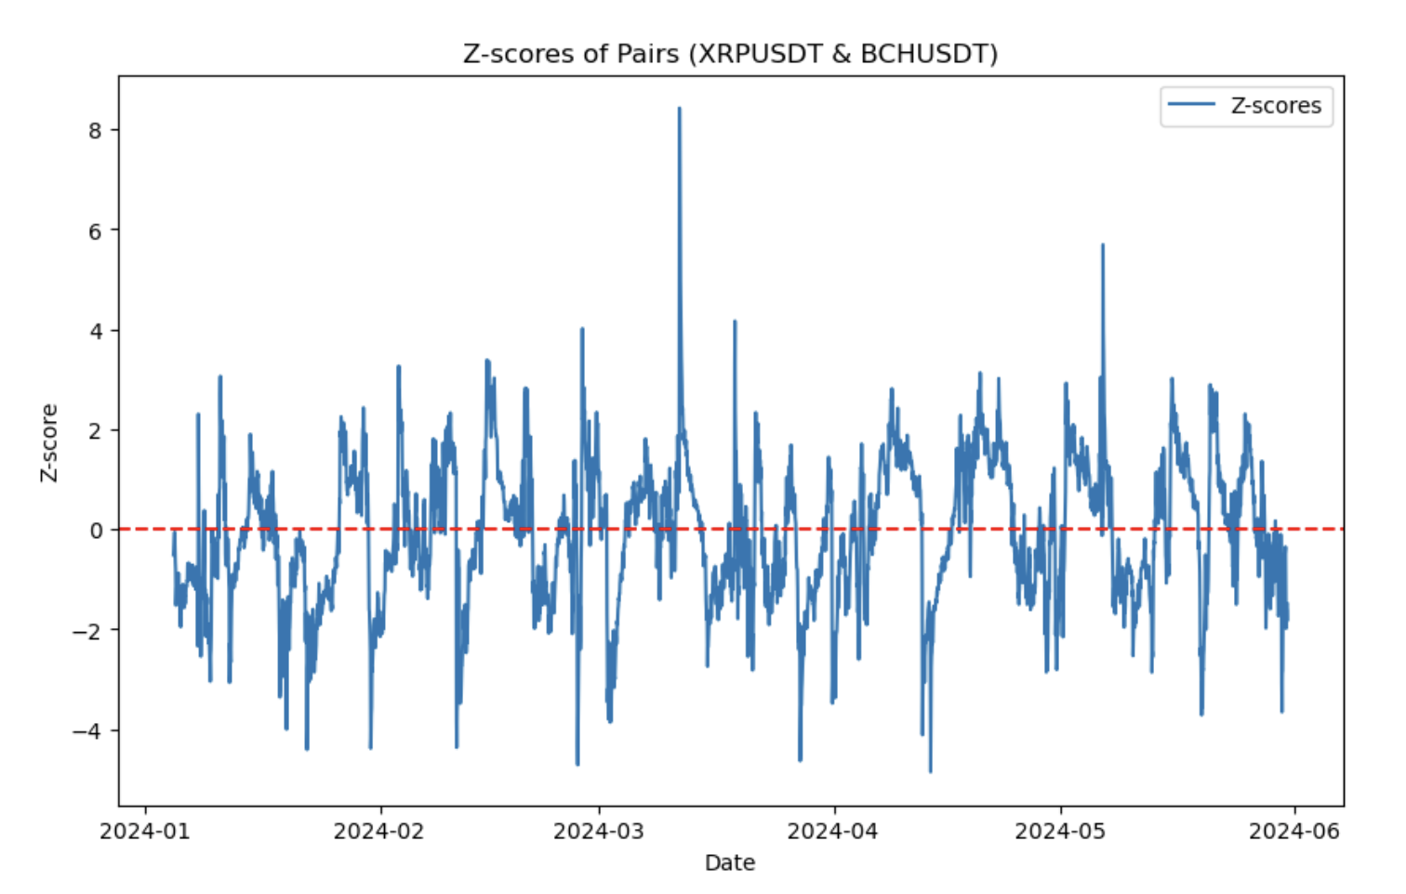
01 Strategy Introduction
02 Cointegration Test
03 Building strategy
04 Stop-Loss
05 Other Risk Management
6. Backtest in test data (2024-01 to 2024-05)
Spread in Year 2024
Z-scores in Year 2024
Explanation
In the first half of 2024, the spread exhibited concentrated unidirectional large fluctuations, indicating that the strategy could also face significant drawdowns.

Slide 25
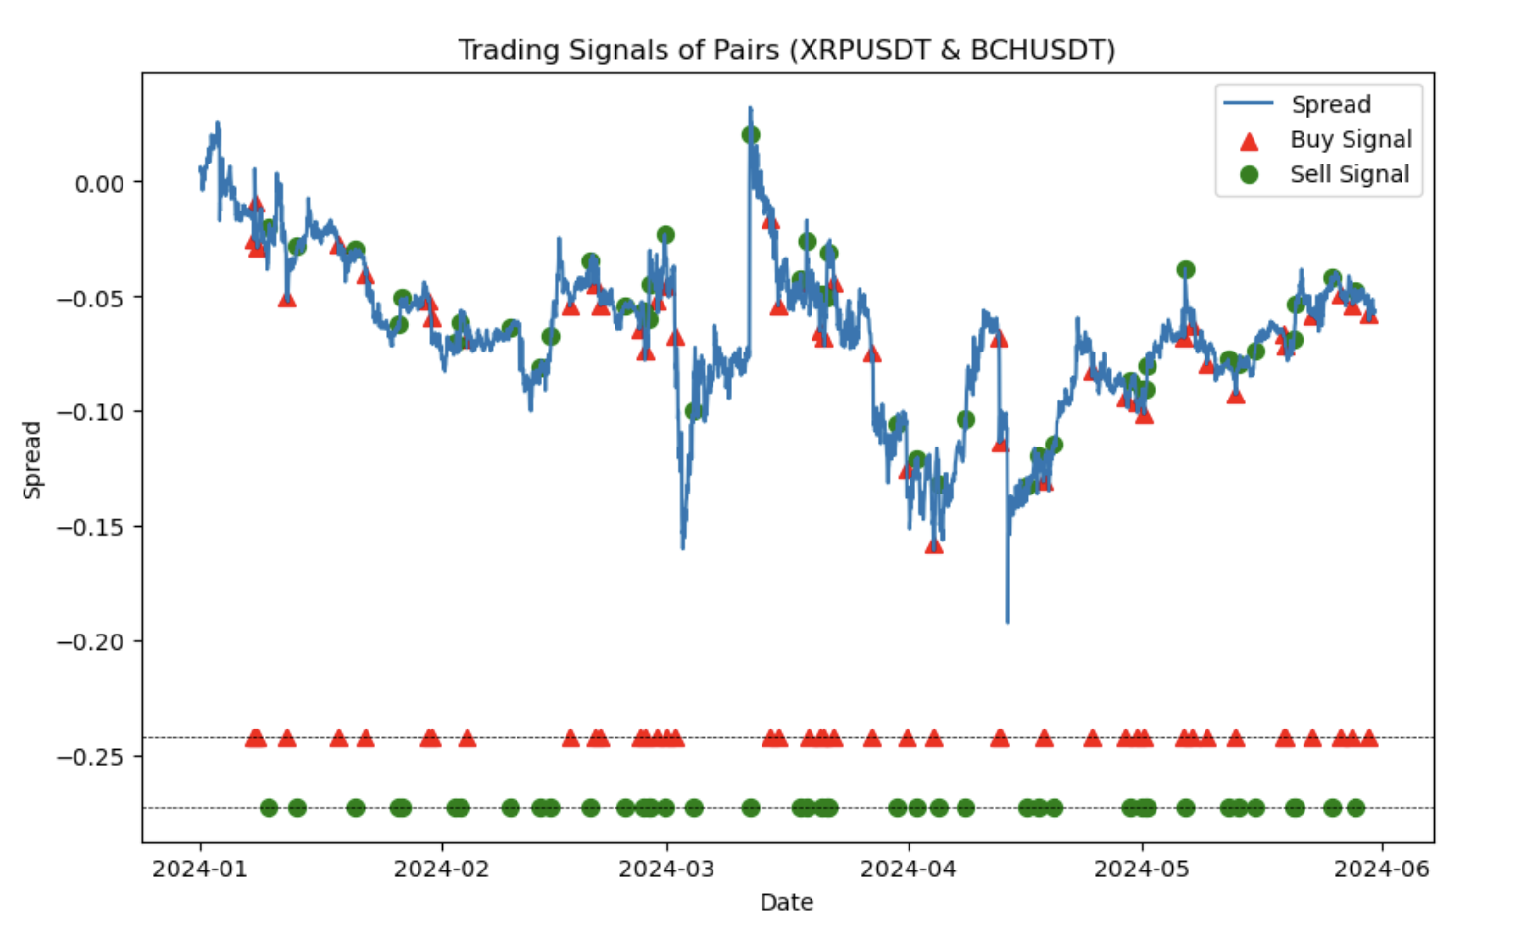
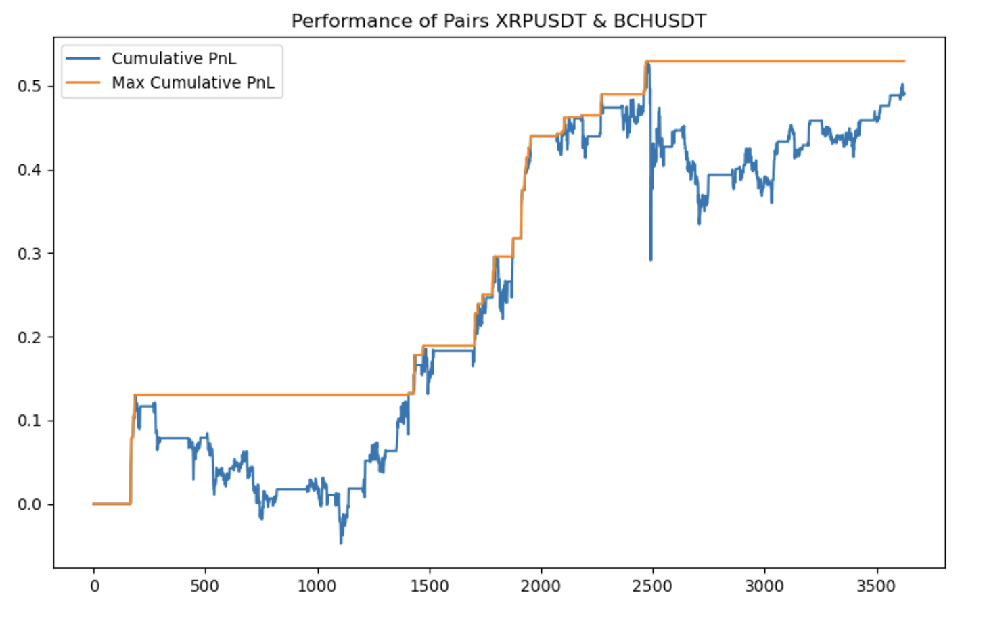
01 Strategy Introduction
02 Cointegration Test
03 Building strategy
04 Stop-Loss
05 Other Risk Management
6. Backtest in test data (2024-01 to 2024-05)
Trading signals
Strategy performance
Explanation
In the first half of 2024, cumulative returns reached 0.5. However, the strategy also faced significant and prolonged drawdowns. Next, we will discuss the performance of the strategy after incorporating stop-loss signals.

Slide 26
4
PART
Stop-Loss Strategy

Slide 27
01 Strategy Introduction
02 Cointegration Test
03 Building strategy
04 Stop-Loss
05 Other Risk Management
Stop-Loss Strategy
Strategy 1
Strategy 2
1
Our second stop-loss strategy attempts to consider past strategy performance. If there are excessively high profits or losses, positions will be closed early.
1
Our first attempt at a stop-loss strategy involves closing positions early when losses exceed a certain threshold.
2
Specifically, the strategy includes adding a stop-loss signal: if losses occur continuously for four hours, the stop-loss signal updates to 0.
2
We use a 15-hours window to calculate the rolling mean and standard deviation of strategy returns.
3
Then, combining the stop-loss signal with the trading signal, we forward-fill to obtain the new position status.
3
A profit rate Bollinger band is plotted with 1.96 standard deviations. If the profit rate exceeds the upper or lower Bollinger band, positions are closed early.

Slide 28
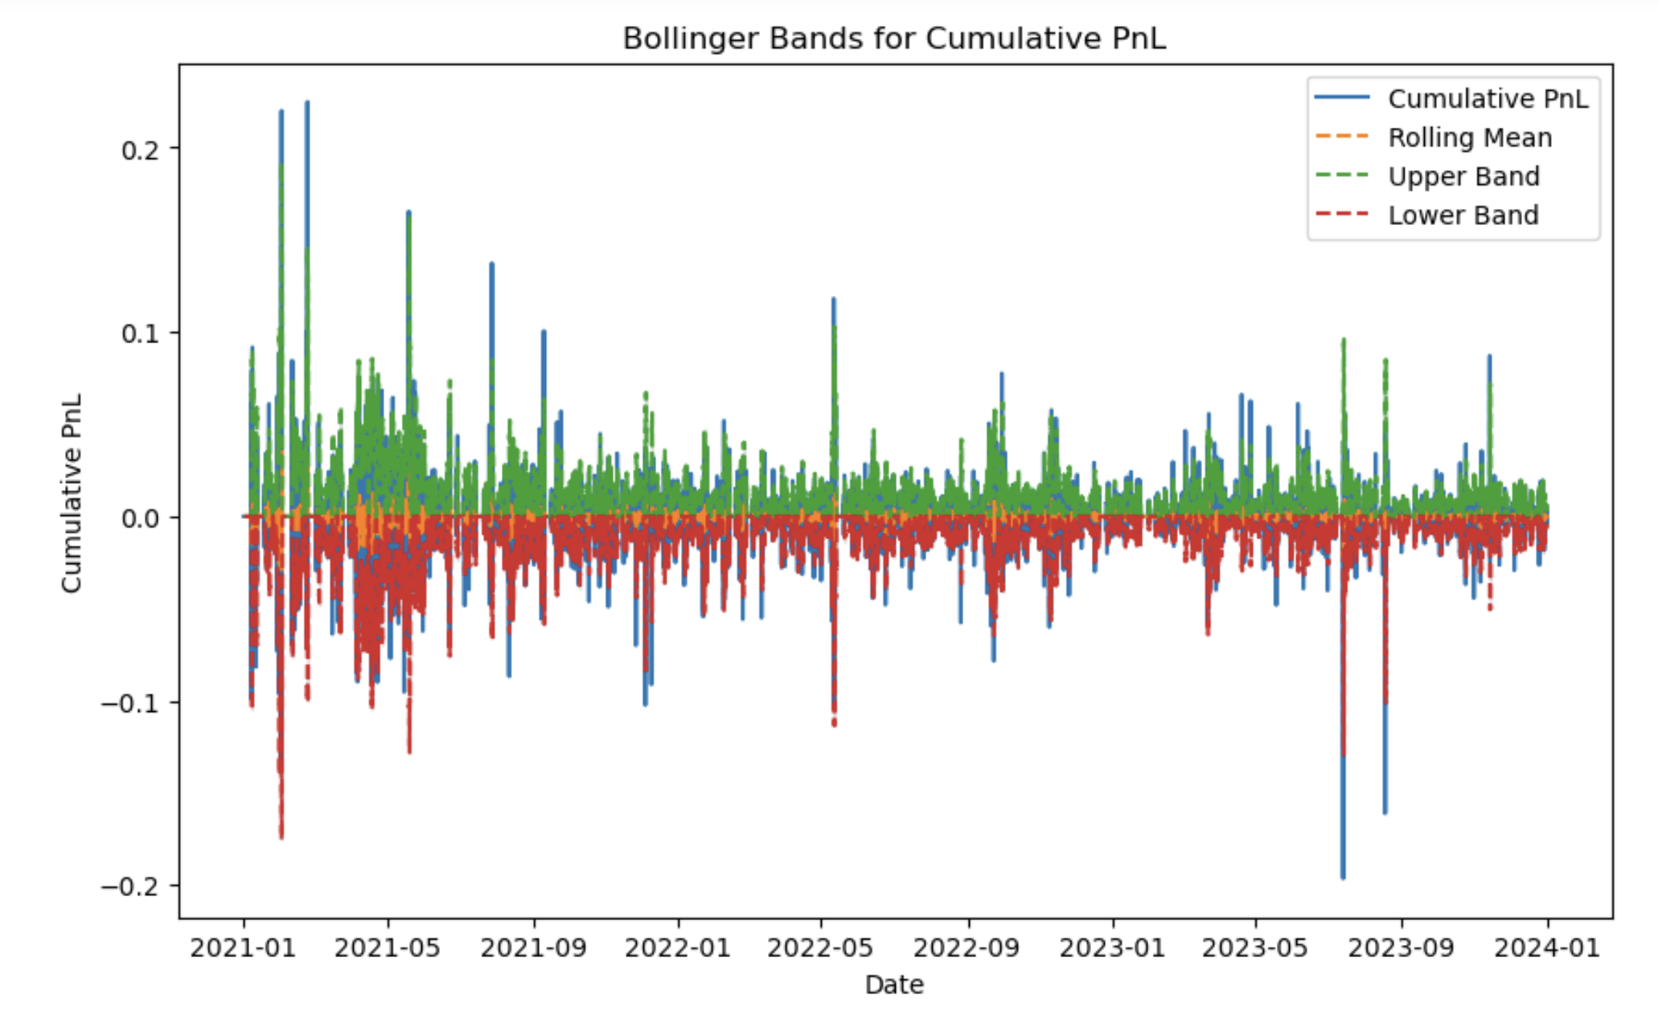
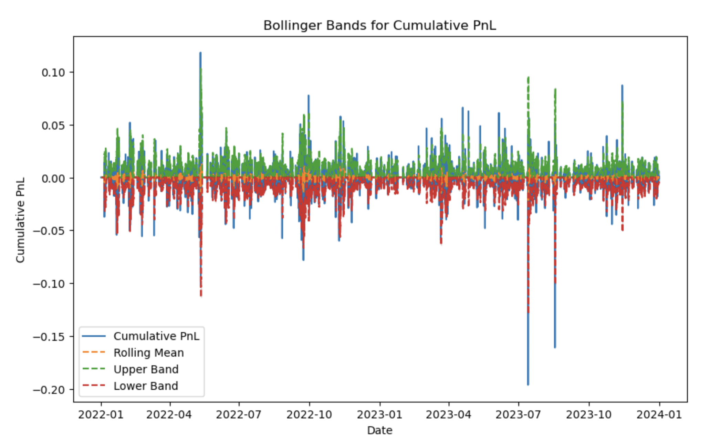
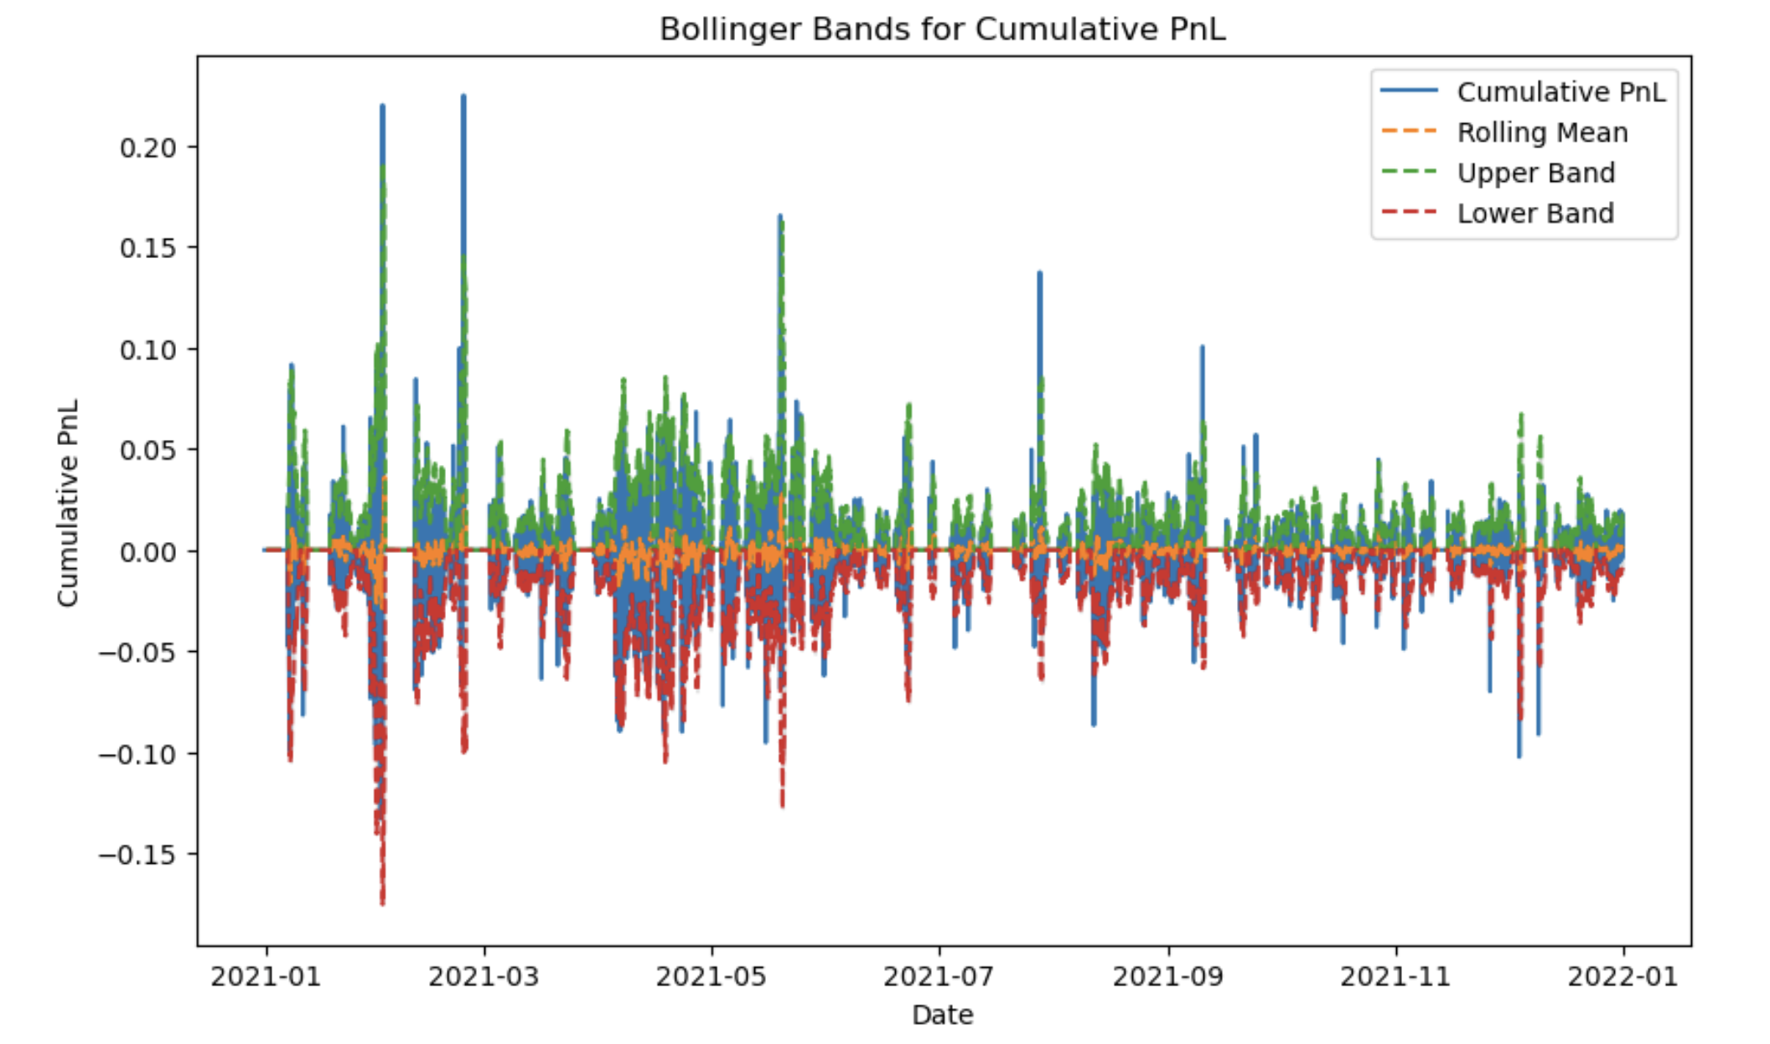
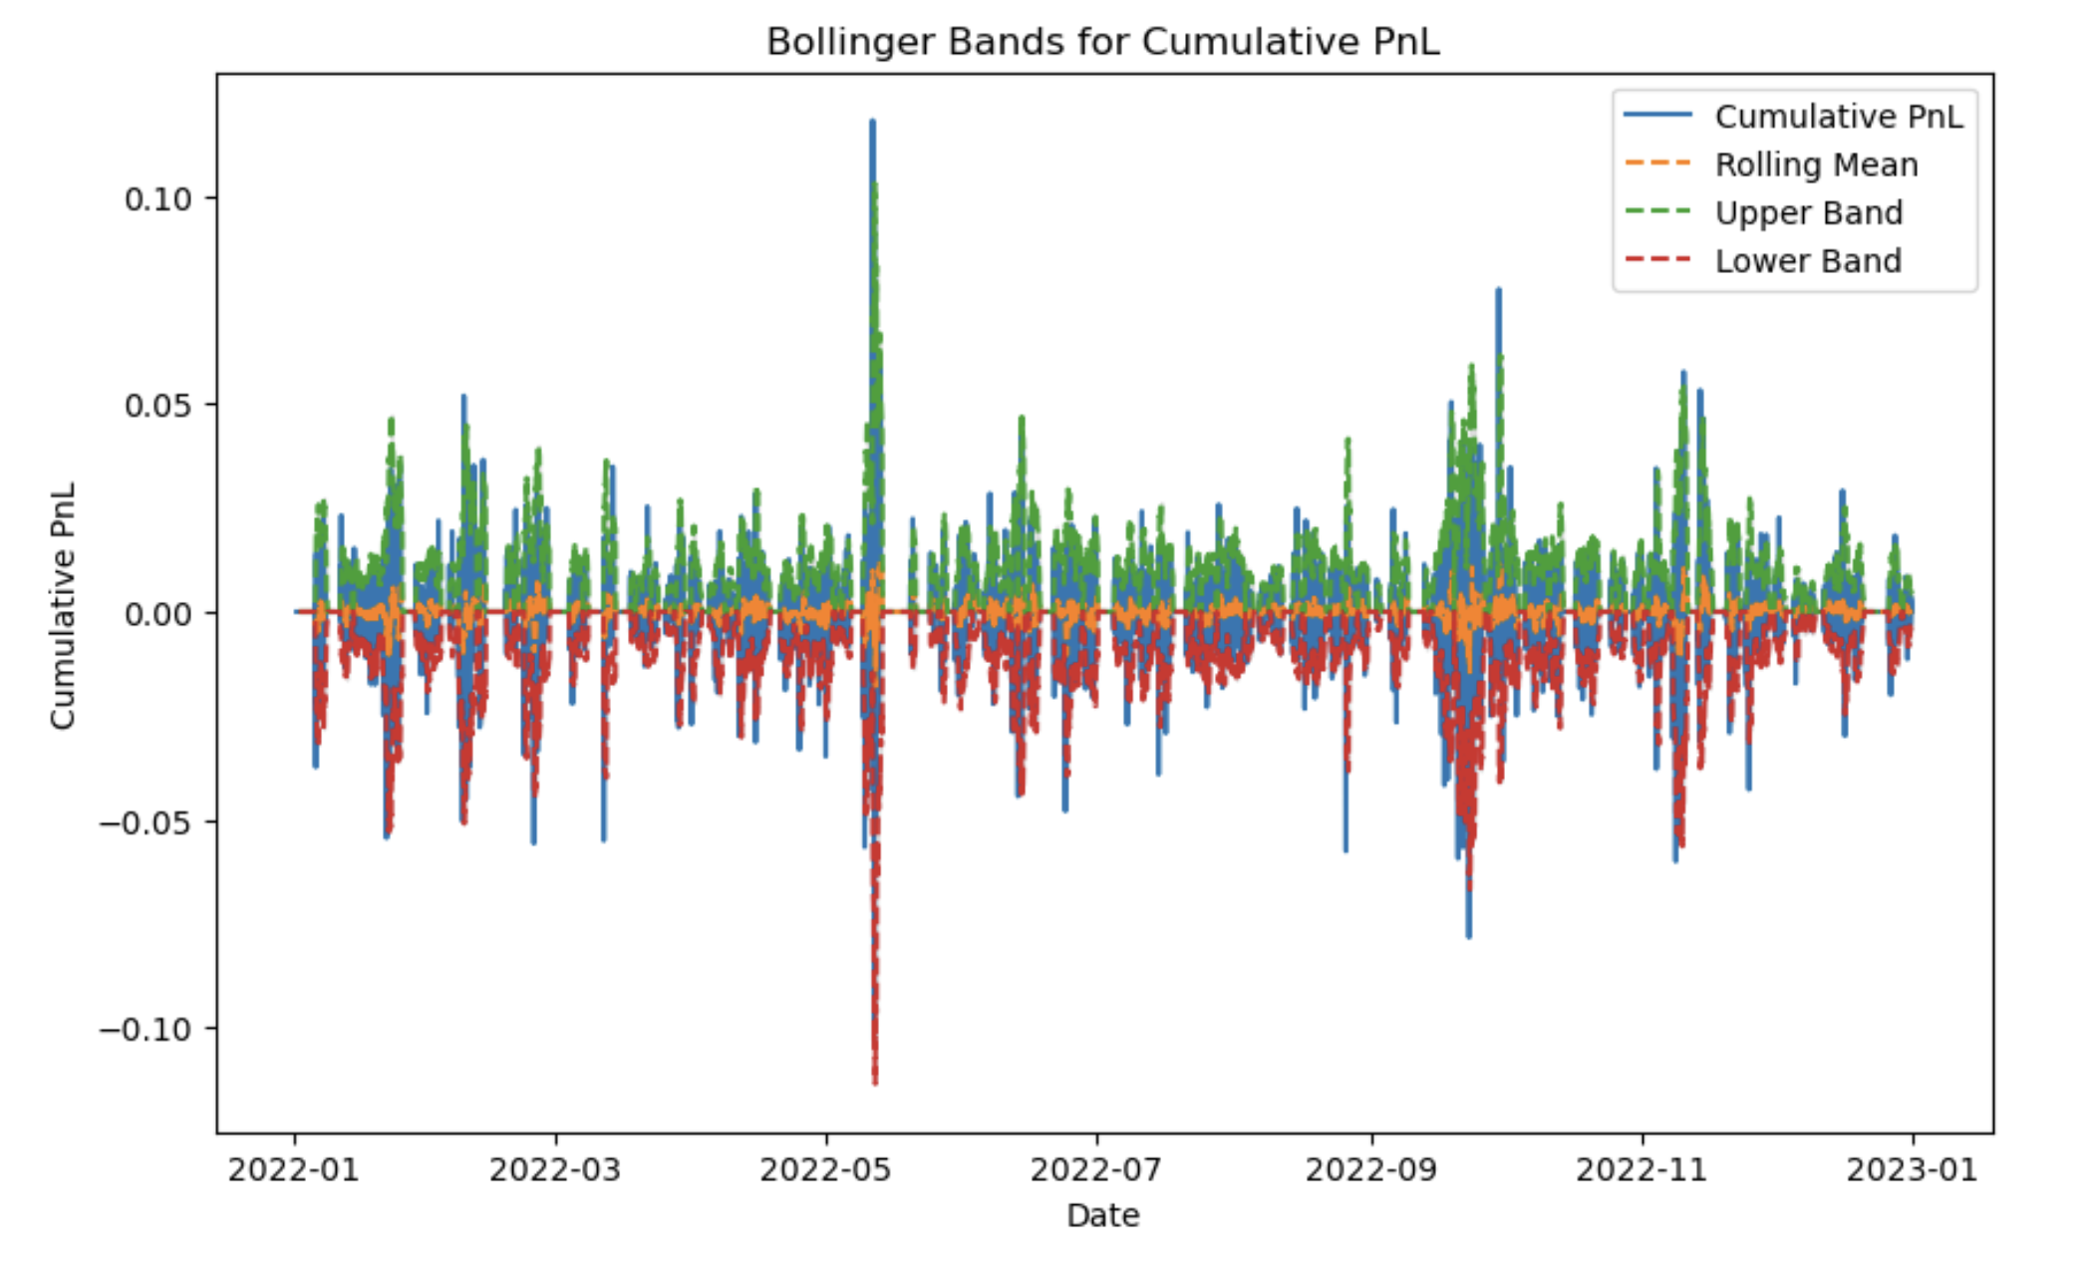
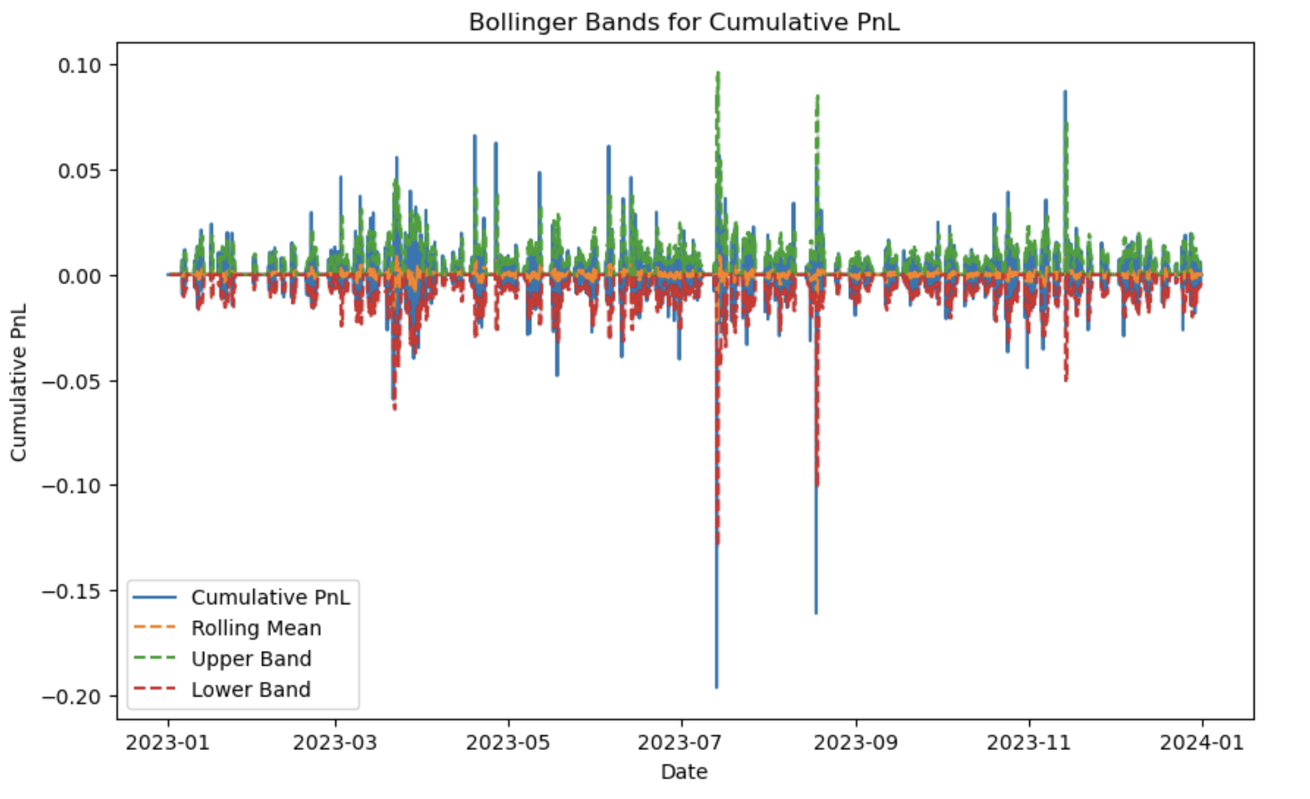
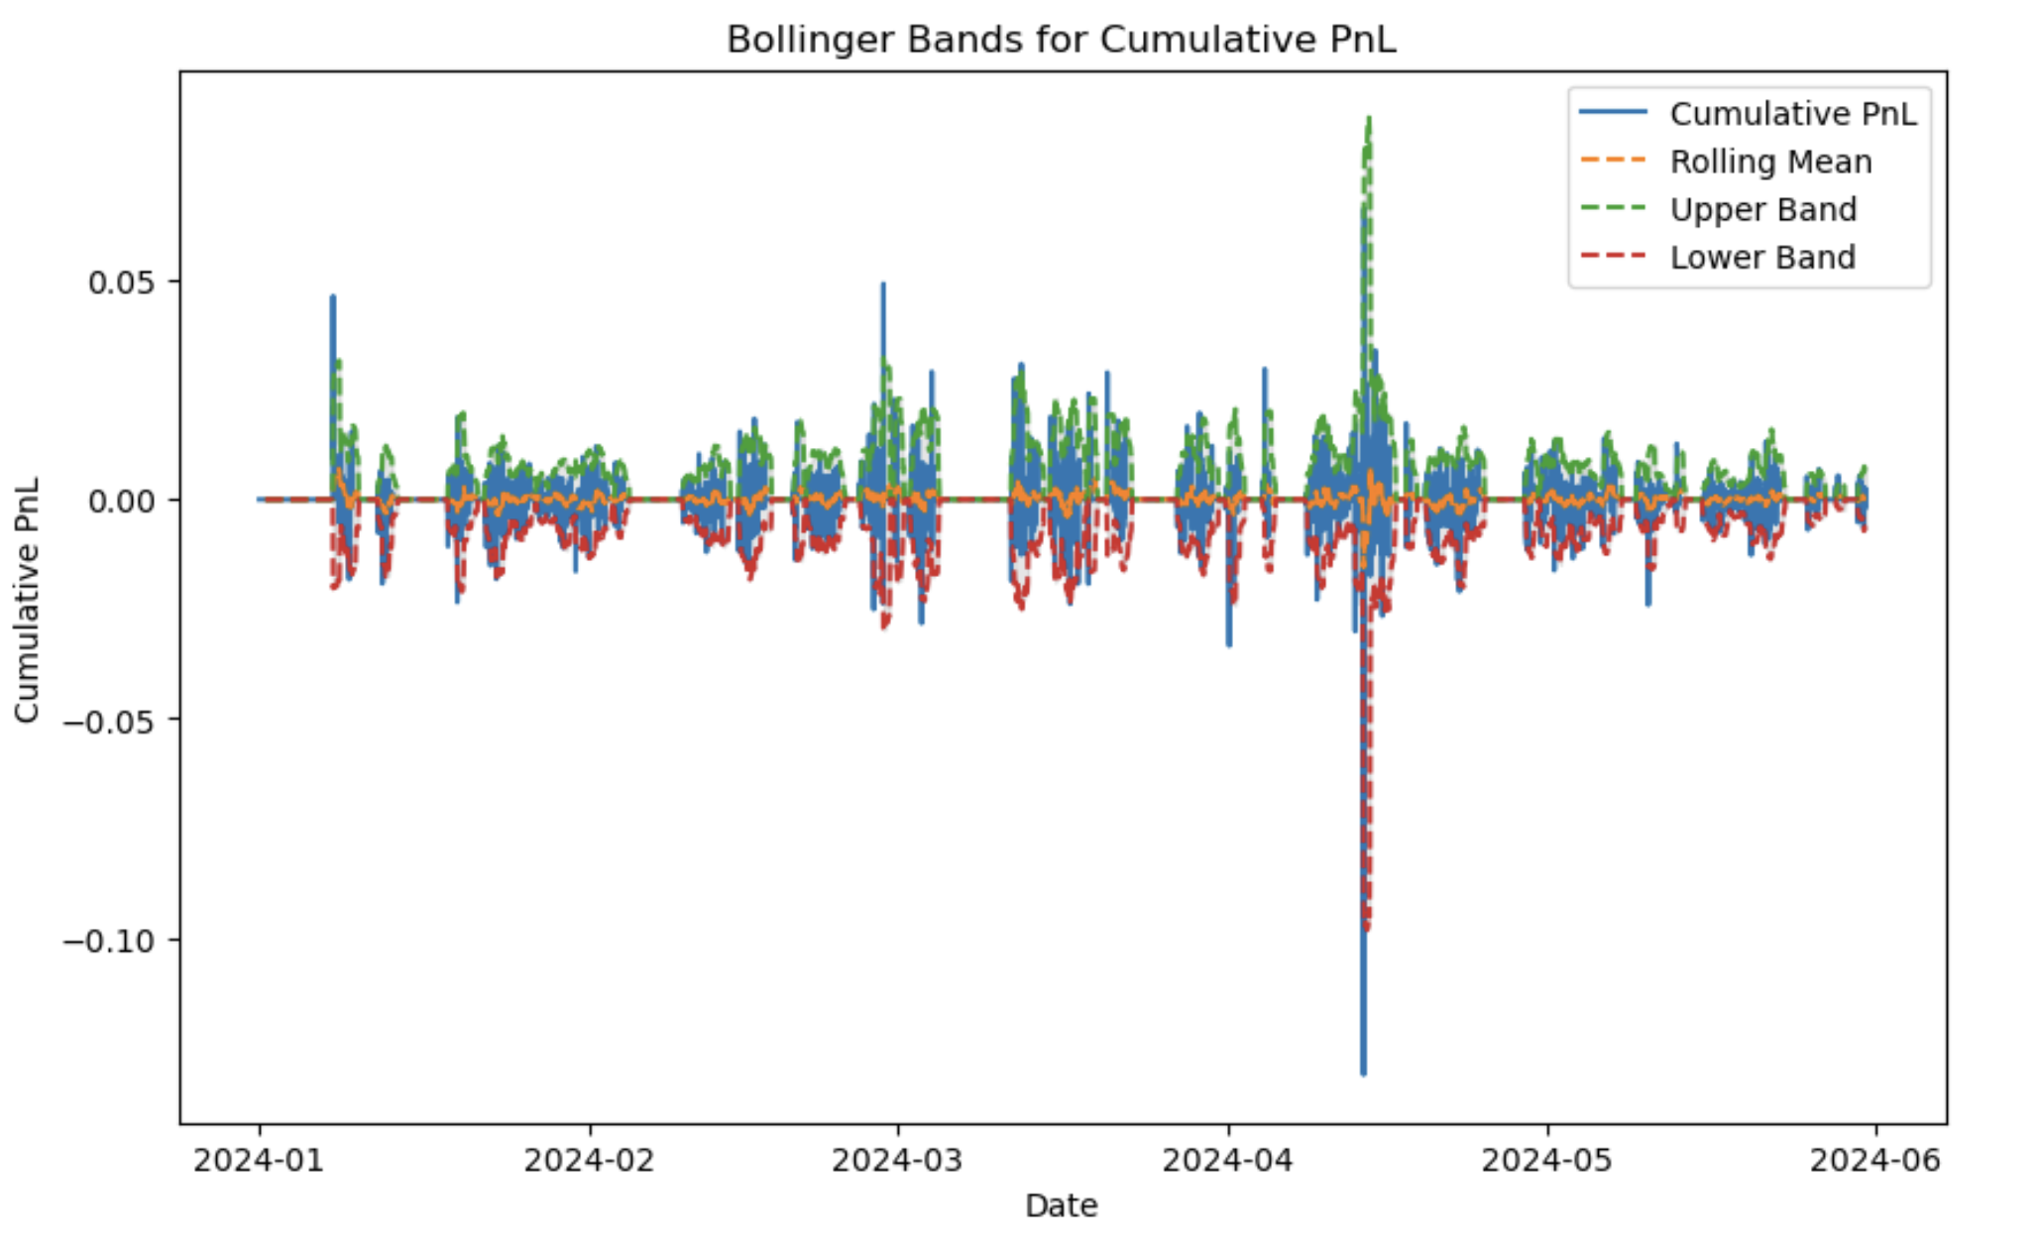
01 Strategy Introduction
02 Cointegration Test
03 Building strategy
04 Stop-Loss
05 Other Risk Management
Bollinger band of Stop-Loss Strategy2
Bollinger band in 2021-2023
Bollinger band in 2022-2023
Bollinger band in year 2021
Conclusion
Bollinger band in year 2022
Bollinger band in year 2023
Bollinger band in year 2024

Slide 29
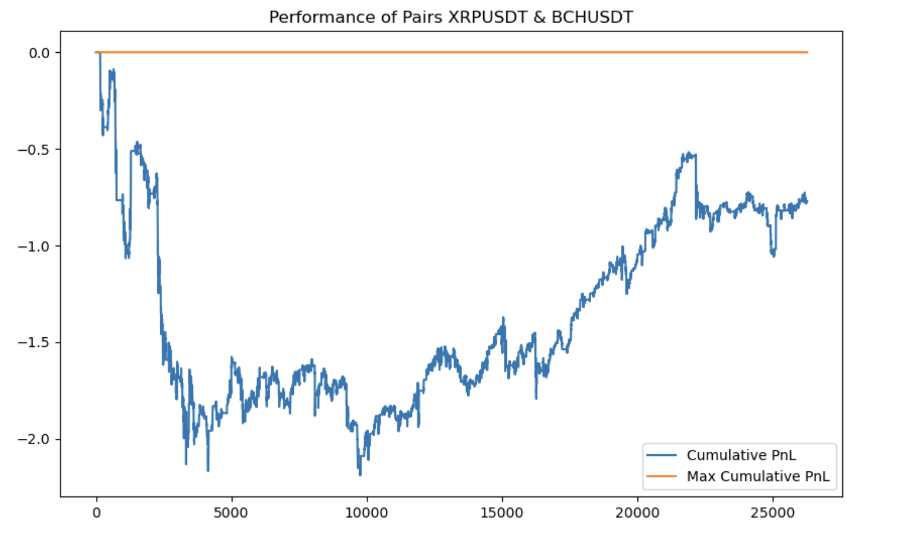
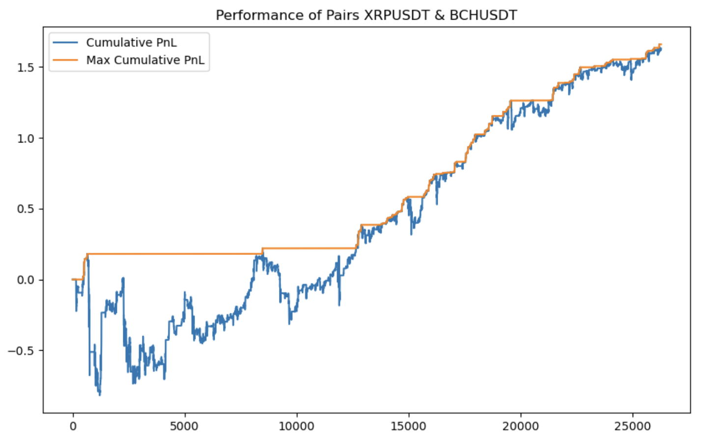
01 Strategy Introduction
02 Cointegration Test
03 Building strategy
04 Stop-Loss
05 Other Risk Management
1. Stop-Loss Strategy comparison (2021-2023)
Stop-Loss Strategy1
Stop-Loss Strategy2
Explanation
From 2021 to 2023, the performance did not improve significantly after incorporating stop-loss strategy 1. However, after implementing stop-loss strategy 2, there was a noticeable improvement in returns.

Slide 30
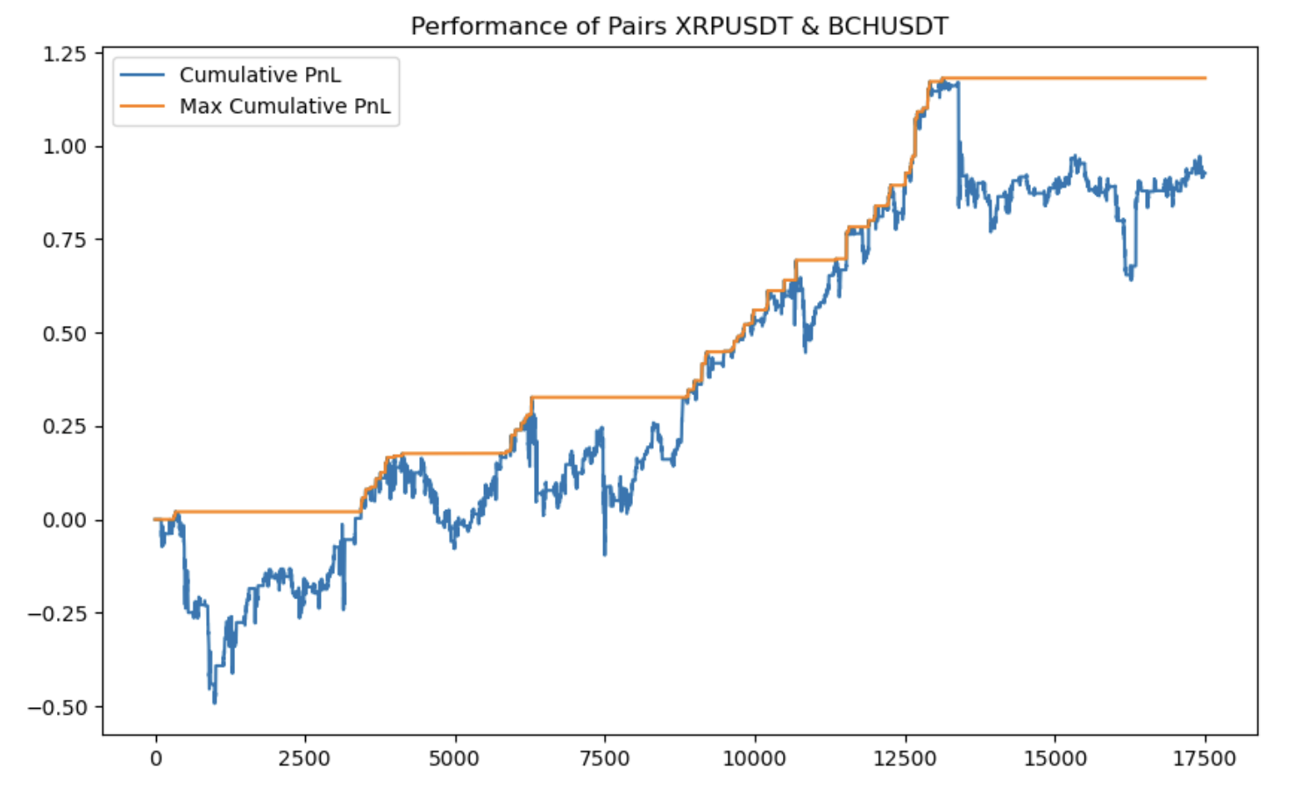
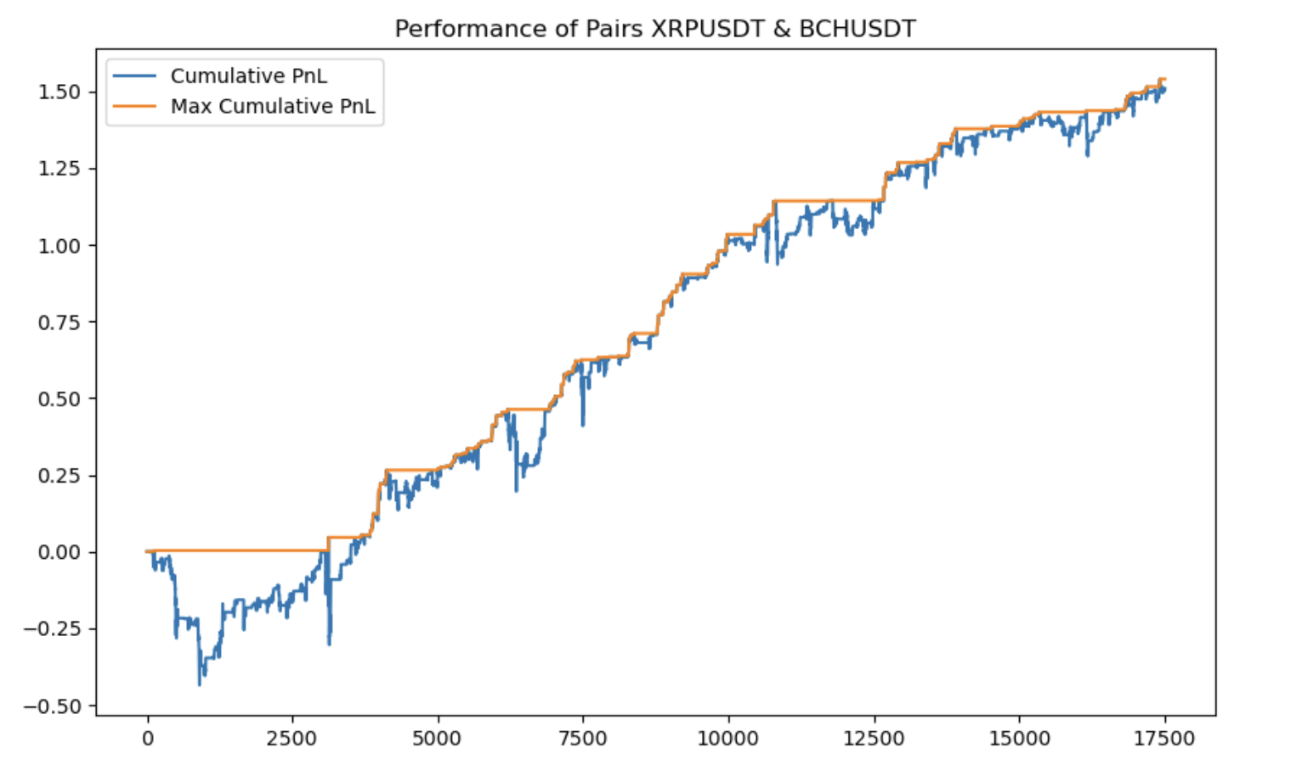
01 Strategy Introduction
02 Cointegration Test
03 Building strategy
04 Stop-Loss
05 Other Risk Management
1. Stop-Loss Strategy comparison (2022-2023)
Stop-Loss Strategy1
Stop-Loss Strategy2
Explanation
From 2022 to 2023, the performance after incorporating stop-loss strategy 1 remained weaker compared to stop-loss strategy 2. Stop-loss strategy 2 outperformed strategy 1 in terms of cumulative profits, maximum drawdowns, and the duration of maximum drawdown periods.

Slide 31
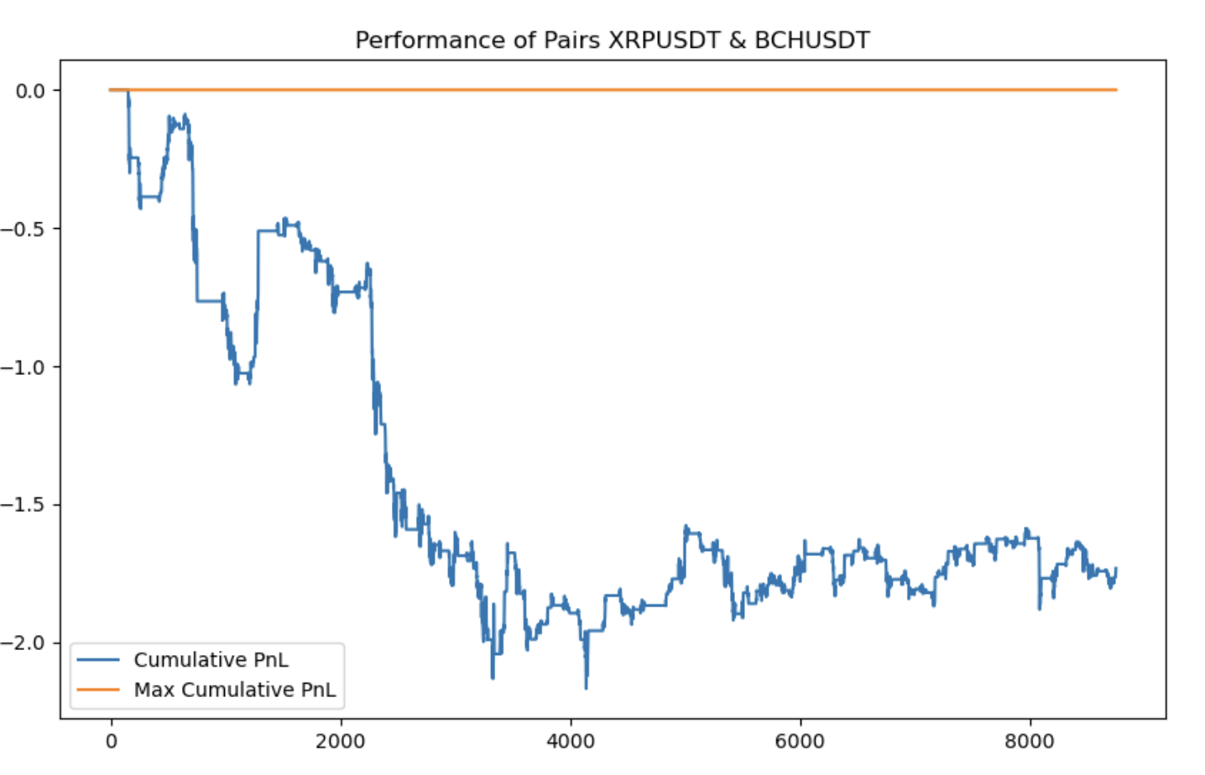
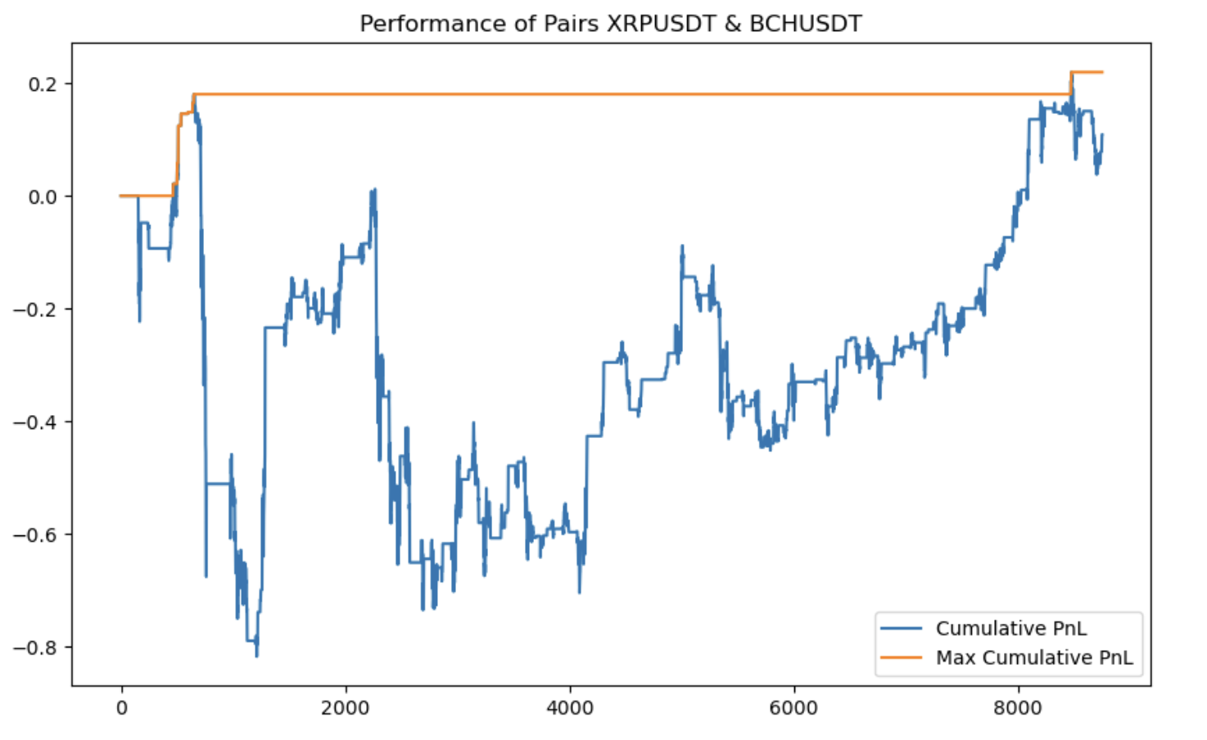
01 Strategy Introduction
02 Cointegration Test
03 Building strategy
04 Stop-Loss
05 Other Risk Management
1. Stop-Loss Strategy comparison (Single year-2021)
Stop-Loss Strategy1
Stop-Loss Strategy2
Explanation
In 2021, extreme market conditions led to continuous losses for the original strategy. Stop-loss strategy 1 performed poorly, and although stop-loss strategy 2 also experienced significant losses initially, its performance improved significantly as the market stabilized. Strategy 2 exhibited better resilience and began to show notable profit increases after the market stabilized.

Slide 32
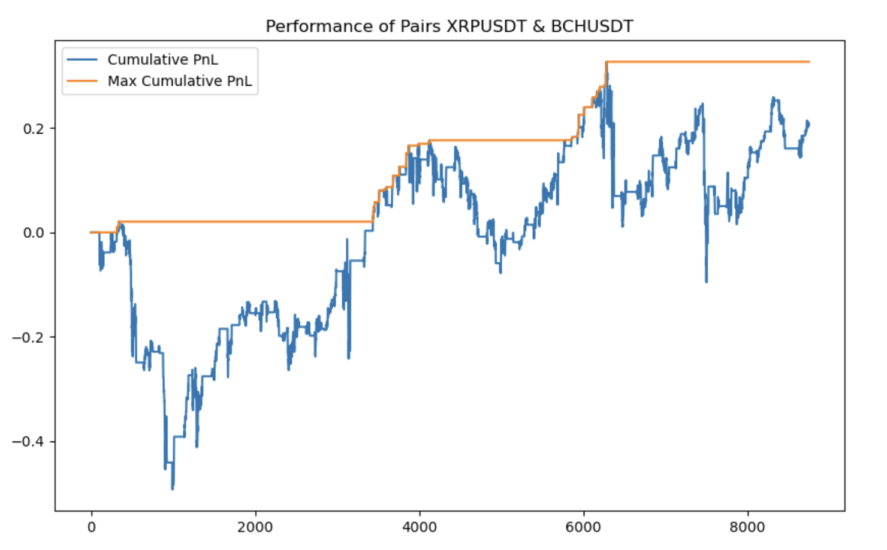
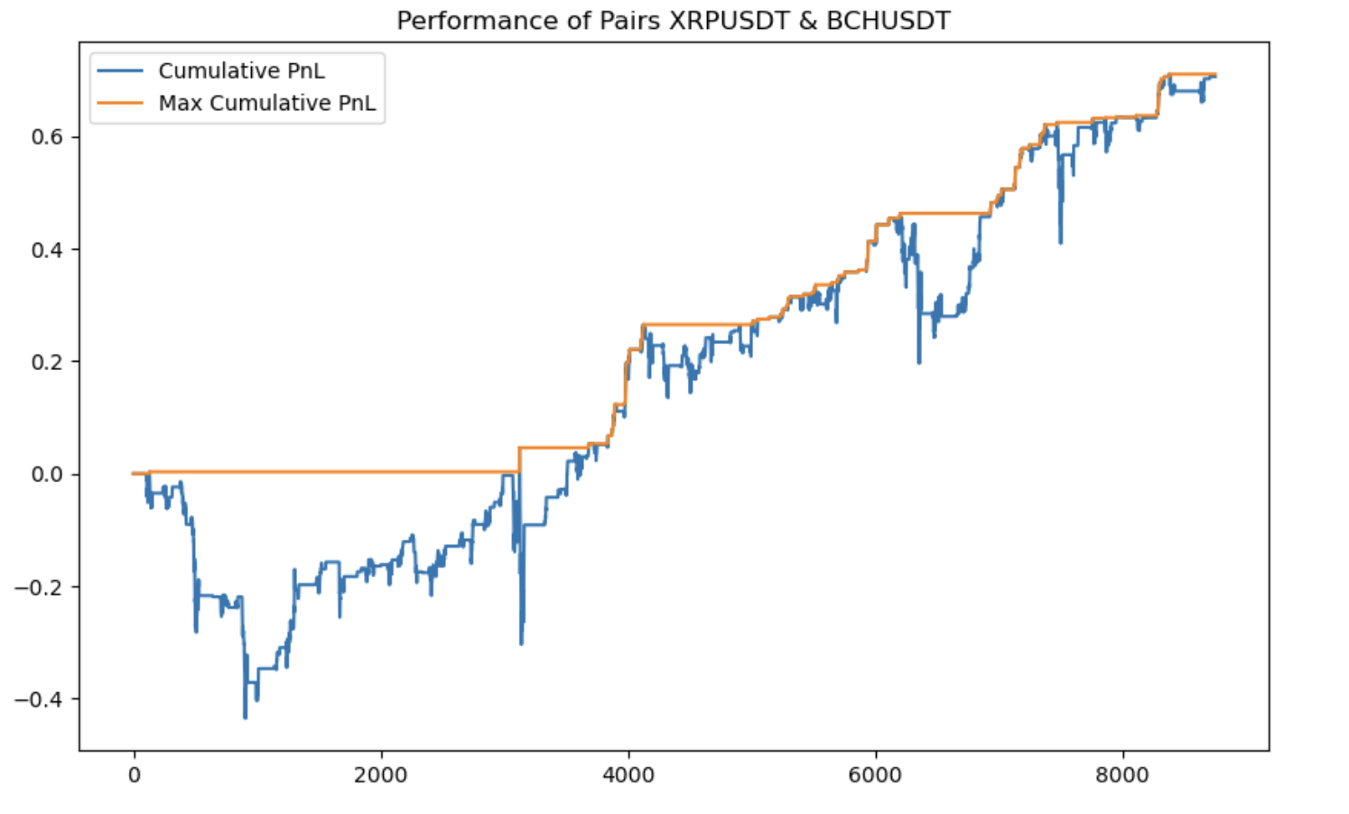
01 Strategy Introduction
02 Cointegration Test
03 Building strategy
04 Stop-Loss
05 Other Risk Management
1. Stop-Loss Strategy comparison (Single year-2022)
Stop-Loss Strategy1
Stop-Loss Strategy2
Explanation
In 2022, despite relatively stable spreads, stop-loss strategy 1 did not perform well and still faced significant drawdowns. In contrast, stop-loss strategy 2 clearly outperformed, demonstrating better results.

Slide 33
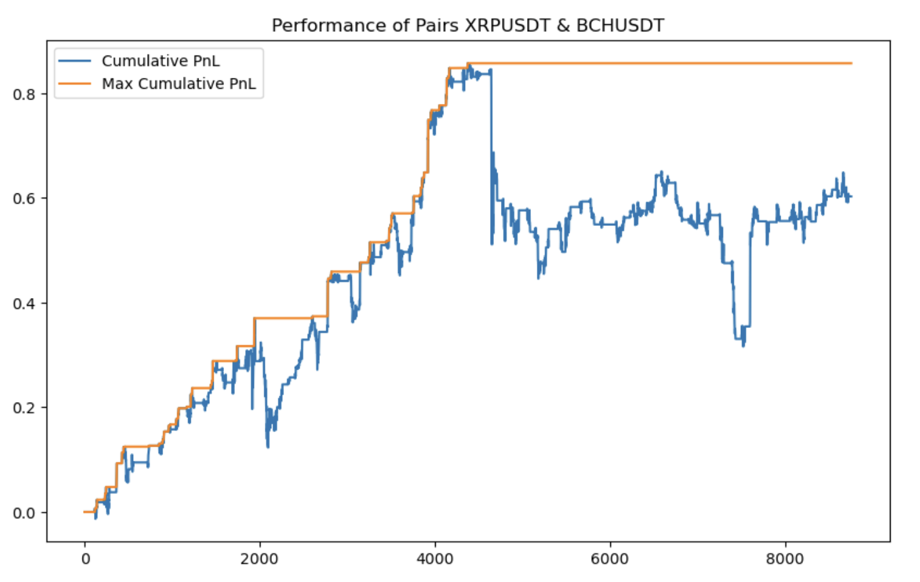
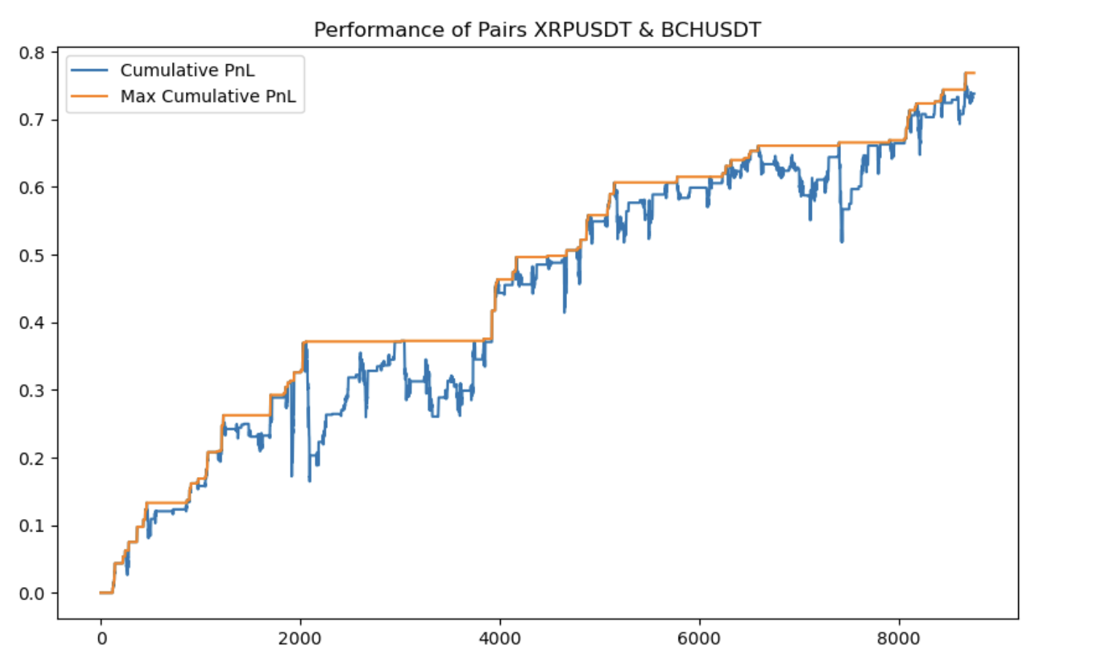
01 Strategy Introduction
02 Cointegration Test
03 Building strategy
04 Stop-Loss
05 Other Risk Management
1. Stop-Loss Strategy comparison (Single year-2023)
Stop-Loss Strategy1
Stop-Loss Strategy2
Explanation
In the early part of 2023, strategy 1 performed well with small drawdowns and steadily rising returns. However, it encountered significant drawdowns later, indicating the stop-loss strategy failed during that period. In contrast, strategy 2 showed better stability, with returns steadily and continuously increasing.

Slide 34
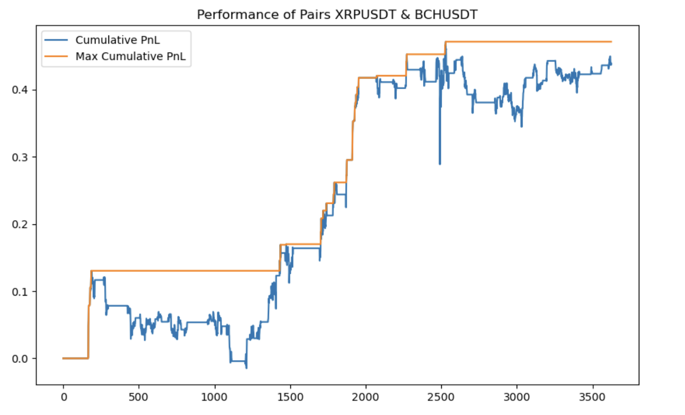
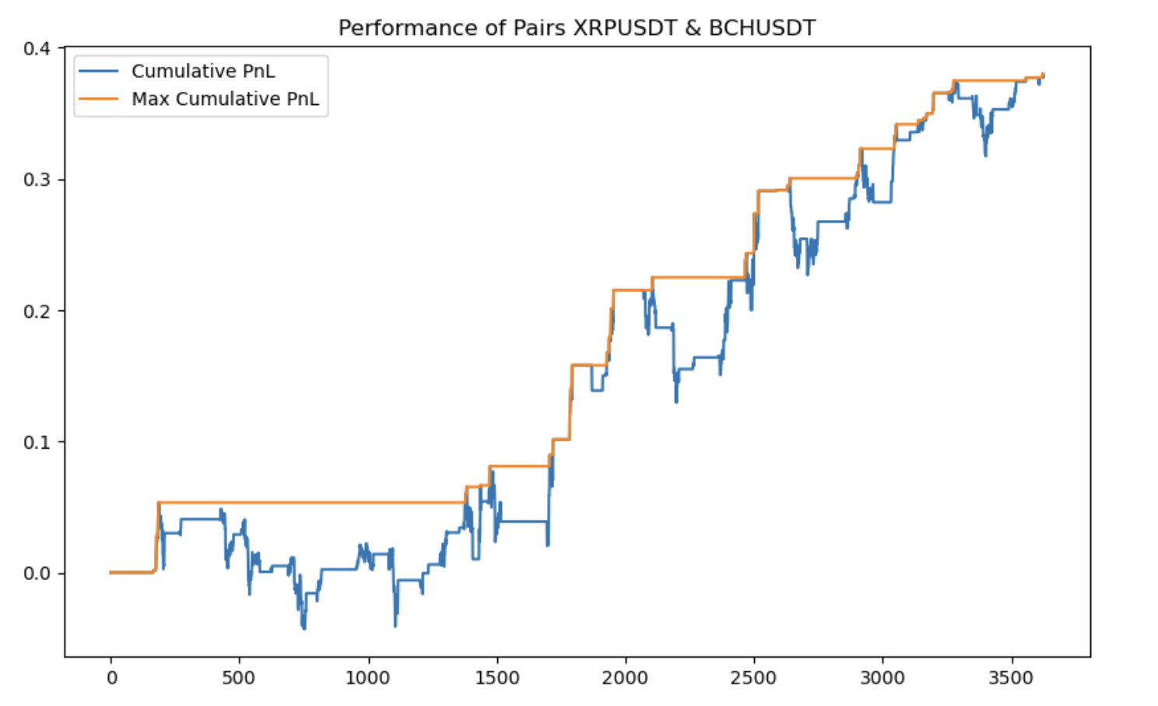
01 Strategy Introduction
02 Cointegration Test
03 Building strategy
04 Stop-Loss
05 Other Risk Management
1. Stop-Loss Strategy comparison (Test data-2024)
Stop-Loss Strategy1
Stop-Loss Strategy2
Explanation
In 2024, the cumulative returns of both stop-loss strategies were similar, but strategy 2 was noticeably more stable. Overall, stop-loss strategy 2 significantly outperformed stop-loss strategy 1. Next, we will compare the returns of the original strategy with those of stop-loss strategy 2.

Slide 35
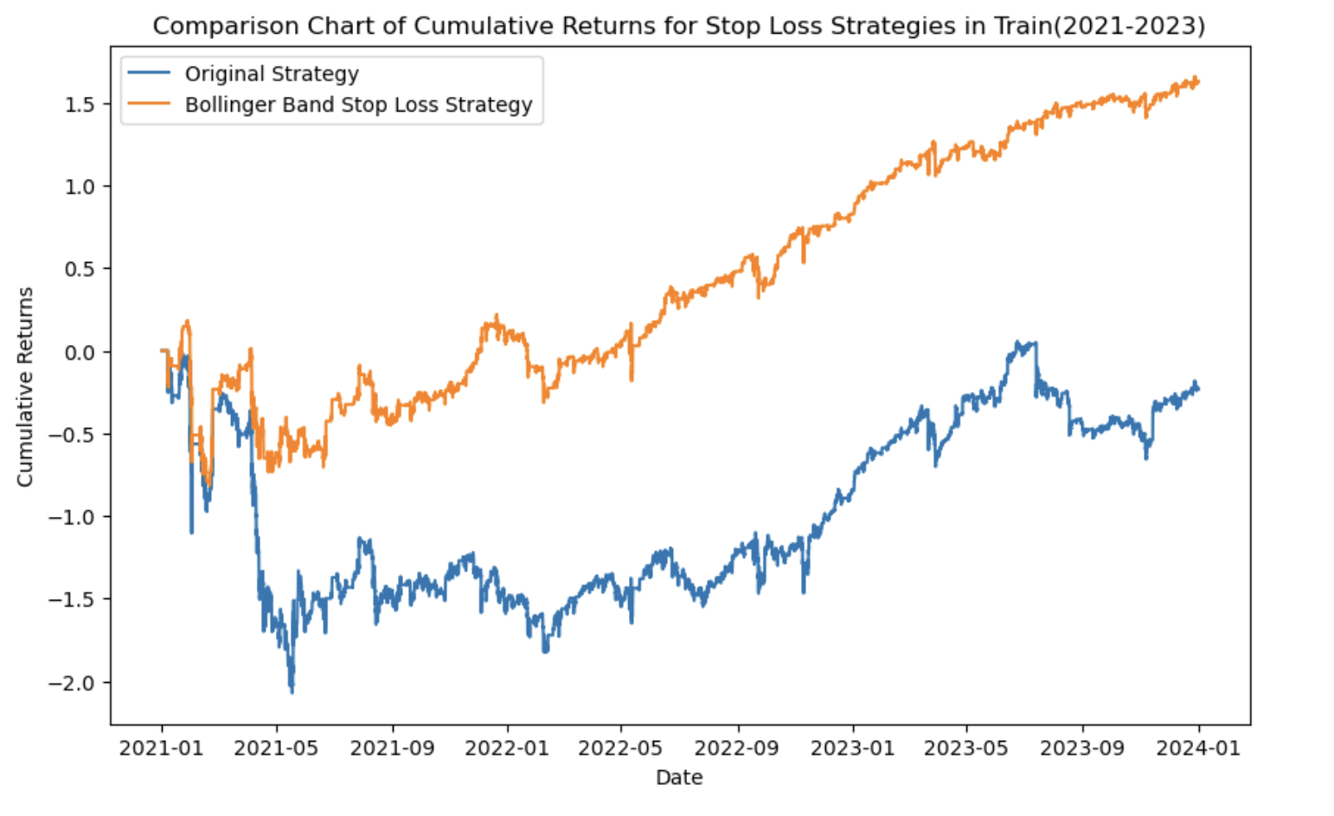
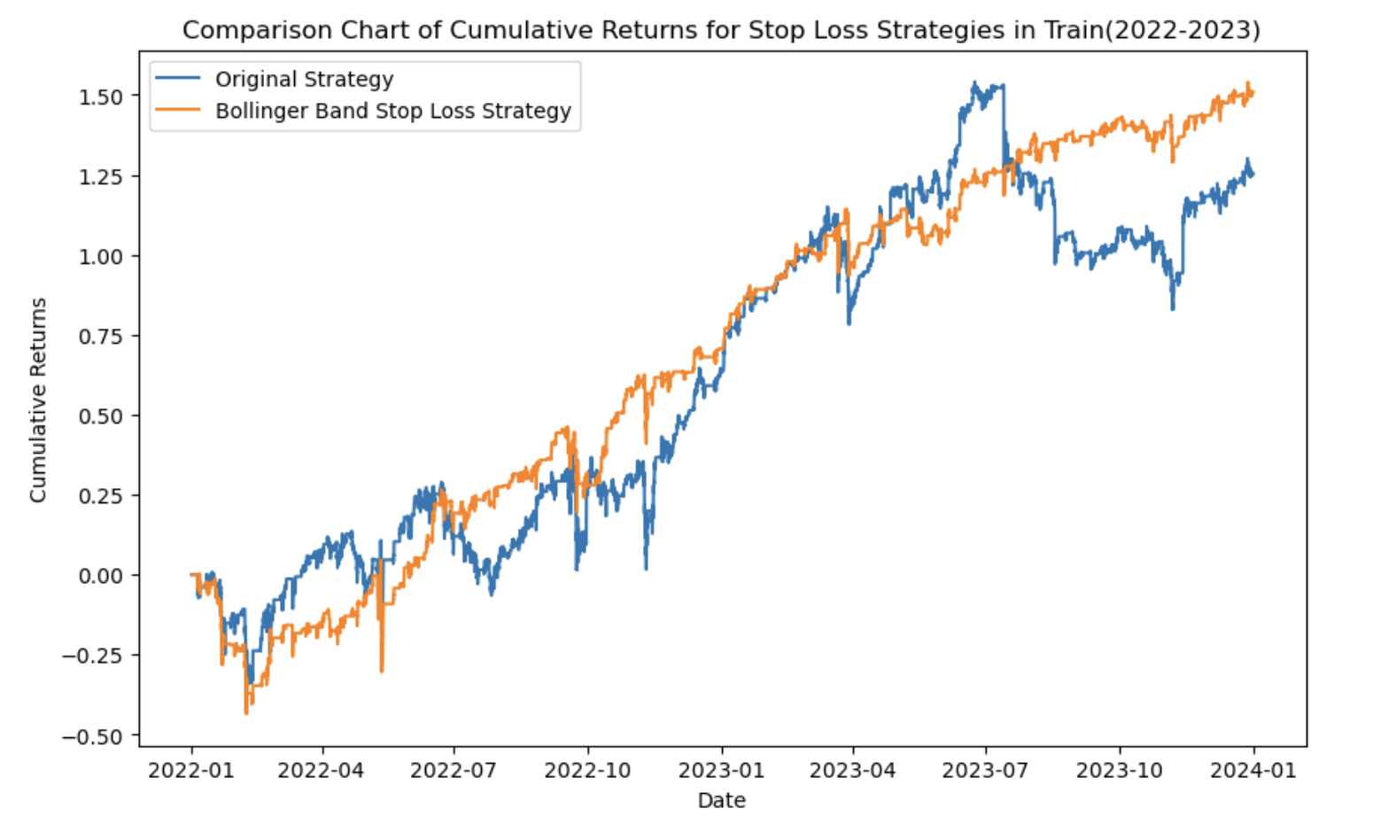
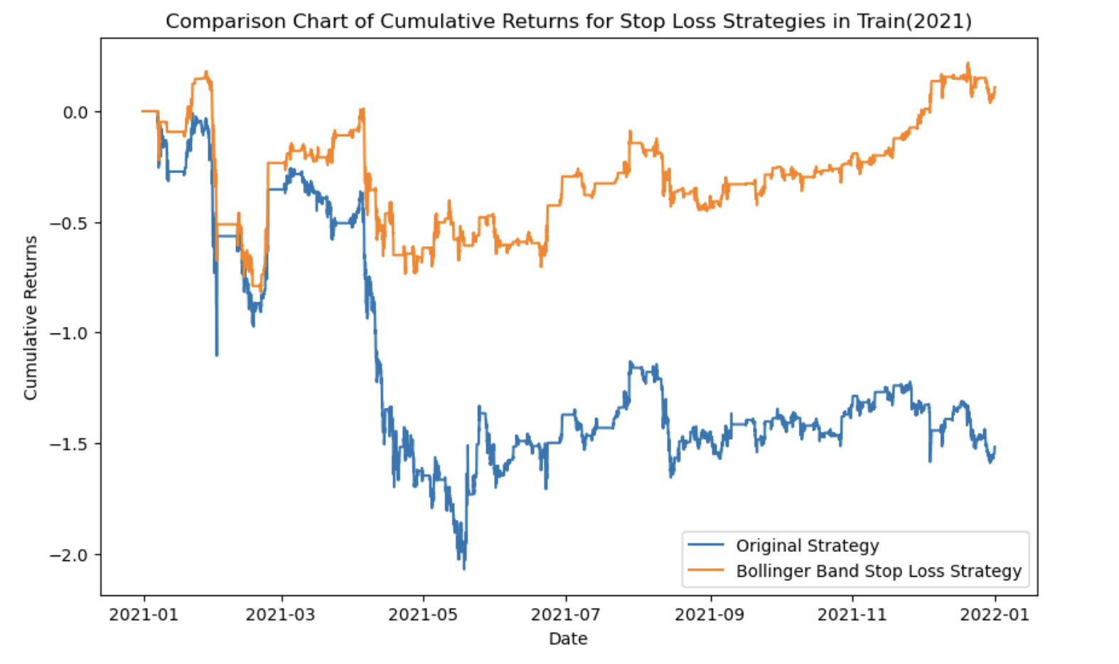



01 Strategy Introduction
02 Cointegration Test
03 Building strategy
04 Stop-Loss
05 Other Risk Management
2. Original Strategy vs Stop-Loss Strategy2
Original trategy vs Stop-Loss in 2021-2023
Original trategy vs Stop-Loss in 2022-2023
Original trategy vs Stop-Loss in year 2021
Conclusion
Original trategy vs Stop-Loss in year 2022
Original trategy vs Stop-Loss in year 2023
Original trategy vs Stop-Loss in year 2024

Slide 36
01 Strategy Introduction
02 Cointegration Test
03 Building strategy
04 Stop-Loss
05 Other Risk Management
3. Performance comparison
 | Year | Stop-Loss | Sharp- ratio | Average annual return(%) | Total return(%) | Max drawdown(%) | Max drawdown period
Train | 2021-2023 | No | -0.0724 | -5.3520 | -23.2487 | -207.2002 | -138days
Train | 2021-2023 | Strategy1 | -0.02810 | -17.7632 | -77.1619 | -219.0617 | -408days
Train | 2021-2023 | Strategy2 | 0.6841 | 37.5762 | 162.9239 | -99.8347 | -51days
Train | 2022-2023 | No | 0.8048 | 43.2340 | 125.1415 | -71.2673 | -675days
Train | 2022-2023 | Strategy1 | 0.6827 | 32.0083 | 92.6484 | -54.1340 | -679days
Train | 2022-2023 | Strategy2 | 1.3525 | 52.1358 | 150.9078 | -43.8633 | -38days
Conclusion

Slide 37
01 Strategy Introduction
02 Cointegration Test
03 Building strategy
04 Stop-Loss
05 Other Risk Management
3. Performance comparison
 | Year | Stop-Loss | Sharp- ratio | Average annual return(%) | Total return(%) | Max drawdown(%) | Max drawdown period
Train | 2021 | No | -1.0178 | -104.8942 | -151.8087 | -207.2002 | -138days
Train | 2021 | Strategy1 | -1.3737 | -119.6947 | -173.2289 | -219.0617 | -408days
Train | 2021 | Strategy2 | 0.0967 | 7.5232 | 10.8879 | -99.8347 | -51days
Train | 2022 | No | 0.7569 | 44.0462 | 63.7024 | -36.8862 | -265days
Train | 2022 | Strategy1 | 0.2807 | 14.3100 | 20.6960 | -51.3048 | -42days
Train | 2022 | Strategy2 | 1.1002 | 48.8476 | 70.6466 | -43.8633 | -38days
Conclusion

Slide 38
01 Strategy Introduction
02 Cointegration Test
03 Building strategy
04 Stop-Loss
05 Other Risk Management
3. Performance comparison
 | Year | Stop-Loss | Sharp- ratio | Average annual return(%) | Total return(%) | Max drawdown(%) | Max drawdown period
Train | 2023 | No | 0.7051 | 34.3708 | 49.7774 | -71.2673 | -310days
Train | 2023 | Strategy1 | 0.9845 | 41.6300 | 60.2907 | -54.1340 | -314days
Train | 2023 | Strategy2 | 1.6145 | 50.9569 | 73.7982 | -20.6833 | -88days
Test | 2024 | No | 1.9317 | 81.9553 | 49.1081 | -28.8509 | -104days
Test | 2024 | Strategy1 | 1.9284 | 73.2232 | 43.8758 | -16.3839 | -104days
Test | 2024 | Strategy2 | 2.3412 | 63.2802 | 37.9179 | -9.6385 | -32days
Conclusion

Slide 39
5
PART
Other Risk Management

Slide 40

01 Strategy Introduction
02 Cointegration Test
03 Building strategy
04 Stop-Loss
05 Other Risk Management
Risk1 - Not rolling beta and alpha
Influence of rolling OLS
Select the same trading pair and also use the past year's data to regress. However, beta and alpha are adjusted only once at the end of each year, rather than being updated with new market information.
The right chart shows the spread trend from 2022 to 2023, excluding the extreme market conditions of 2021.
It can be seen that without using rolling OLS, the spread does not fluctuate stably around zero; instead, it remains significantly above zero and experiences rapid increases and decreases.
not rolling beta and alpha
rolling beta and alpha

Slide 41



01 Strategy Introduction
02 Cointegration Test
03 Building strategy
04 Stop-Loss
05 Other Risk Management
Risk1 - Not rolling beta and alpha
not rolling, 2024, spread
not rolling, 2022-2023, no stop-loss
not rolling, 2022-2023,stop-loss2
 | Year | Stop-Loss | Sharp- ratio | Average annual return(%) | Total return(%) | Max drawdown(%) | Max drawdown period
Rolling | 2024 | Strategy2 | 2.3412 | 63.2802 | 37.9179 | -9.6385 | -32days
Not Rolling | 2024 | Strategy2 | 1.0502 | 31.2582 | 18.73 | -14.45 | -146days

Slide 42
01 Strategy Introduction
02 Cointegration Test
03 Building strategy
04 Stop-Loss
05 Other Risk Management
Risk1 - Not rolling beta and alpha
Stop-loss strategy failure
Spread
Conclusion
Without rolling beta and alpha, the spread was consistently deviated from zero in 2024, and became significantly negative over the following six months. This contradicts our assumption that the spread would fluctuate around zero.
When the spread does not exhibit mean reversion to zero, the trading direction of our strategy is incorrect, as the spread exhibits more momentum characteristics during this period.
Although the cointegration relationship should be long-term and stable, it is difficult to accurately determine the beta value just through a single regression. Adopting the Rolling OLS method is more advantageous.

Slide 43

01 Strategy Introduction
02 Cointegration Test
03 Building strategy
04 Stop-Loss
05 Risk Management
Risk2 - Unstable cointegration relationship
Only one cointegration test
Cointegration test in 2022-2023
Our trading strategy requires a biennial approach, where we annually roll over and assess the cointegration of historical trading data.
However, if we only select the most recent two years of data each year before trading, choosing the pair or pairs with the smallest p-value, these cointegration pairs may not be stable in the long-term cointegration relationship.

Slide 44
01 Strategy Introduction
02 Cointegration Test
03 Building strategy
04 Stop-Loss
05 Risk Management
Risk2 - Unstable cointegration relationship
Only one cointegration test
If we intend to trade in 2024 and select trading pairs based on data from 2022-2023, 'BNBUSDT' and 'EOSUSDT' have the smallest p-values.
However, if review the cointegration test chart showed before, we can observe that the cointegration relationship for this pair occurred only once. Therefore, such selection methods may filter out potentially unstable cointegration relationships. Which will be a risk!

Slide 45




01 Strategy Introduction
02 Cointegration Test
03 Building strategy
04 Stop-Loss
05 Risk Management
Risk2 - Unstable cointegration relationship
one cointegration test, spread in year 2023
one cointegration test, P&L in year 2023
one cointegration test, spread in year 2024
one cointegration test, P&L in year 2024

Slide 46
01 Strategy Introduction
02 Cointegration Test
03 Building strategy
04 Stop-Loss
05 Risk Management
Other risks can take into consideration
Market impact
Sending order
If there is a systemic risk such as the situation in 2021, how would the strategy respond
(i.e opposite positions)?
It is necessary to use forward-looking indicators to detect whether the market is reversing.
The strategy backtest uses closing prices, but the actual trading price is uncertain. limit orders or market orders?
To complete the pairing, market orders must be used.
Cointegration
Others
Here, we concentrate on the cointegration of assets to select pairs. In actual trading, whether they are on the same blockchain can also be taken into consideration.
Is that an hourly frequency reasonable?
The strategy has not yet considered trading costs.
What are the contingency plans for technical issues?

Slide 47
Singapore Management University
QF 635 Project
Thank you!

